Slide 1




SasView : A Small Angle Scattering Analysis Software Package
Andrew Jackson, European Spallation Source
on behalf of the SasView Collaboration
SINE 2020 WP 10 Meeting, Grenoble, 24th – 25th April 2017

Slide 2
Analysis Software - Who’s Job is it Anyway?
Analysis is where the science is → the USER’S JOB
Scattering is an analysis tool and part of providing the tool should be the necessary software → the FACILITY’S JOB
Data sat on disk is useless to EVERYBODY
We need to work together!

Slide 3
Analysis Software - Who’s Job is it Anyway?
But … where are the resources?
More pressing tasks for all of us ...
Facility scientists & staff : maintaining & improving instrumentation, bringing in and supporting users, dealing with instrument control and data reduction software …
Users : data analysis should be high priority ... But in fact the priority is publication. Users want to get rapidly from data to answer – if it is going to need major investment of time then low priority. Especially for “one-time” and industrial users.
Writing shareable data analysis software is bottom of the heap ...
… need to pool resources.

Slide 4



A little history …
Where did SasView come from?
DANSE project output
~ 8.5% of funds were for SANS
Kickoff meeting August 2006
Heritage: NIST IGOR macros

Slide 5
Continuity …
NIST Supported initial transition from NSF funding

Slide 6
Expansion …
NIST supported initial transition from NSF funding
Now 8 active facilities
ORNL, ISIS, NIST, ESS, ILL, TUD/RID, ANSTO and Diamond
SINE2020 funding two staff at ESS
First major investment since DANSE
http://sine2020.eu

Slide 7
Development Model
Open, Collaborative, Community Development
Code is open source and publicly hosted at Github
Released under BSD 3-clause license
Bug and Enhancement Ticket System
Bi-weekly developer calls
Code Camps
1st at NIST April 2013
2nd at ISIS April 2014
3rd at ESS Feb 2015
4th at TU Delft/RID March 2016
5th at ORNL October 2016
6th at ILL/ESRF April 2017
5 Year Roadmap
http://www.sasview.org
http://github.com/SasView

Slide 8
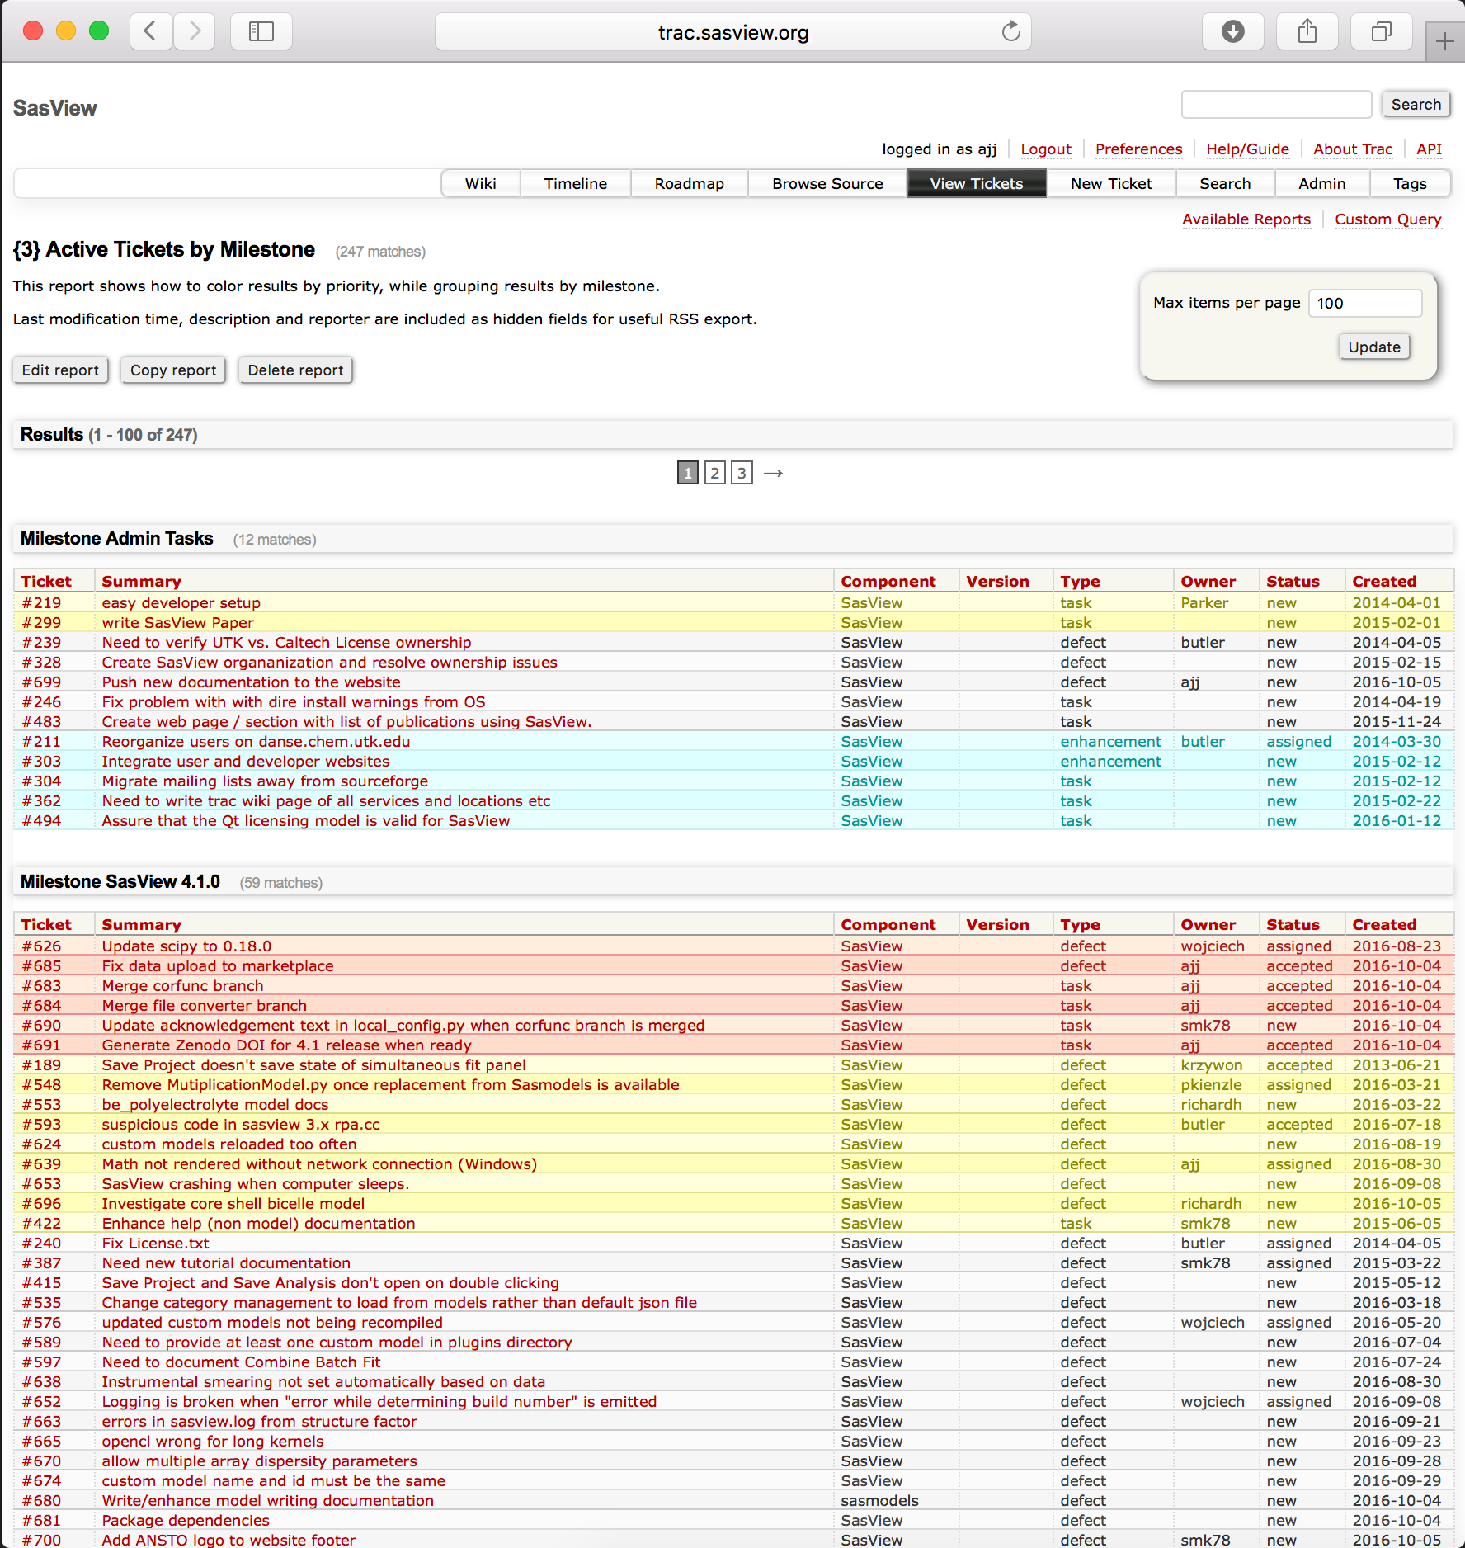
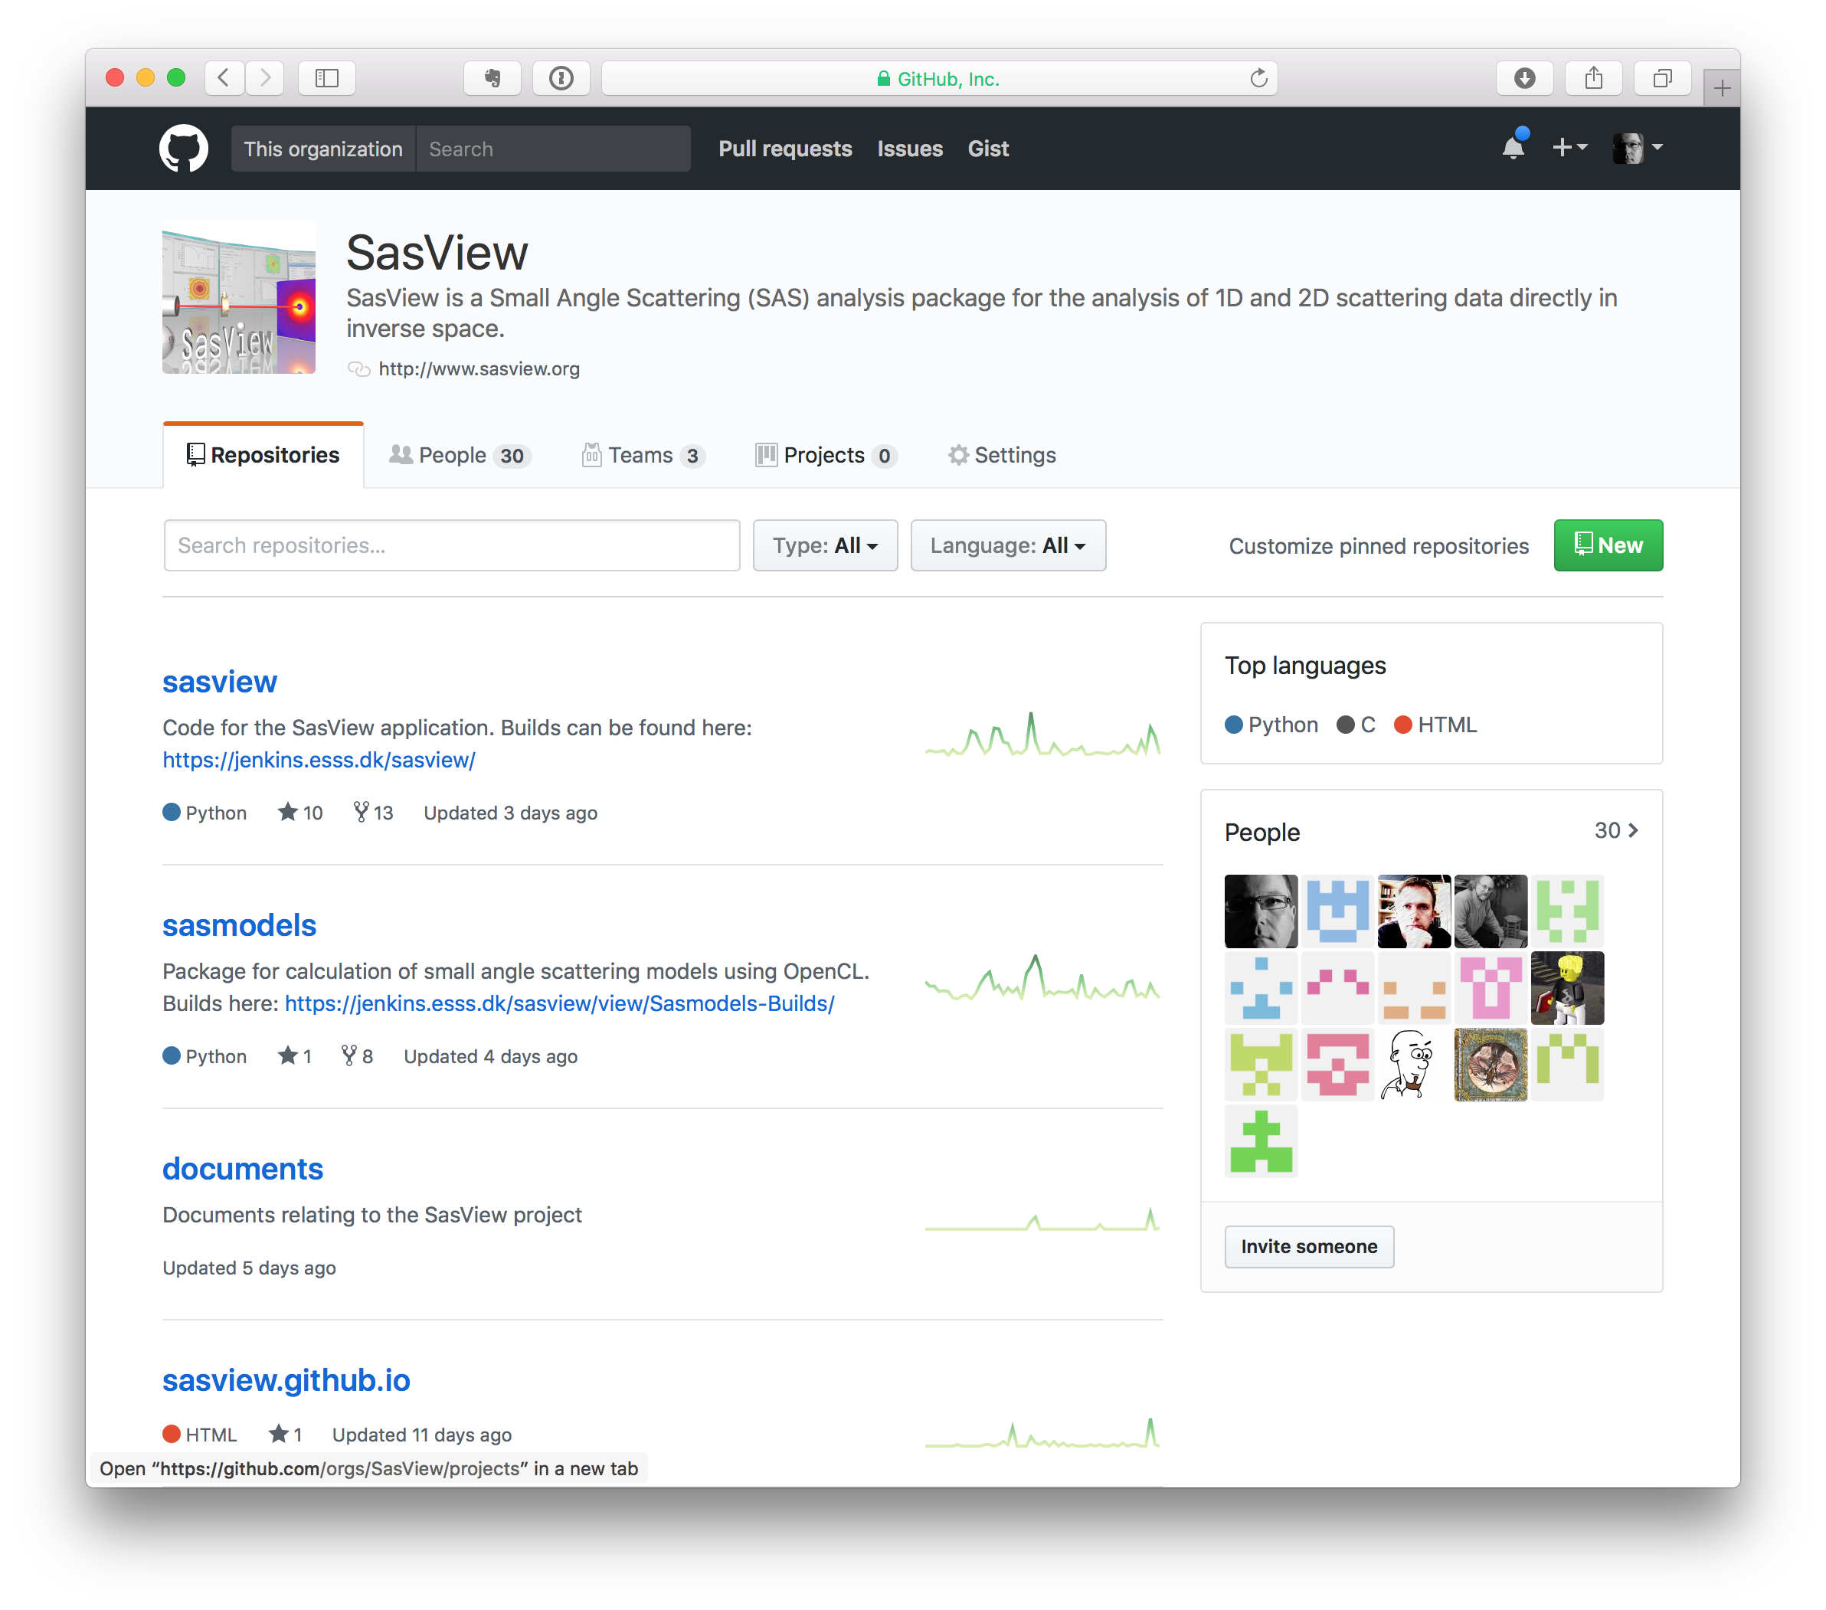
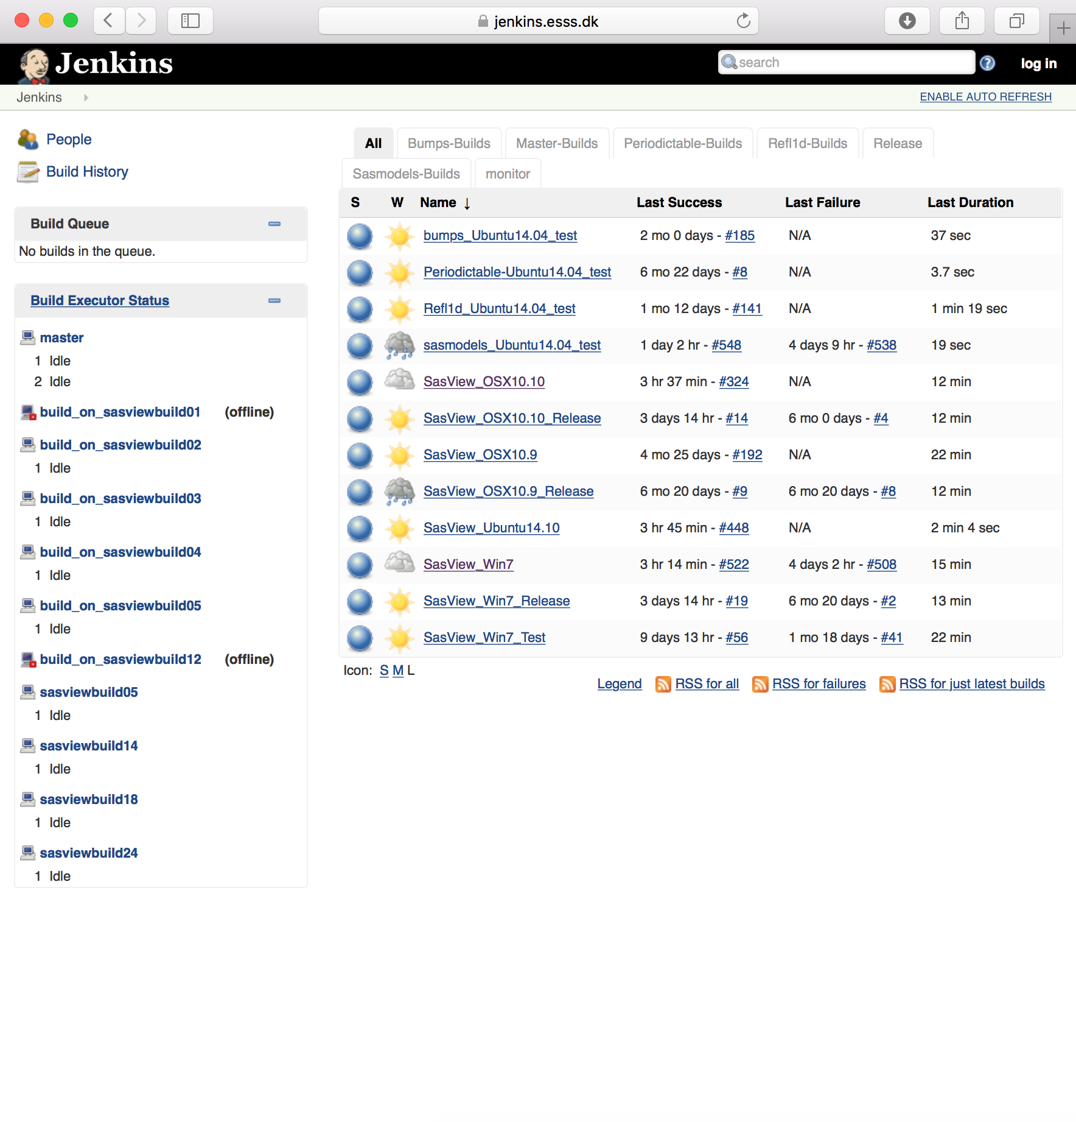
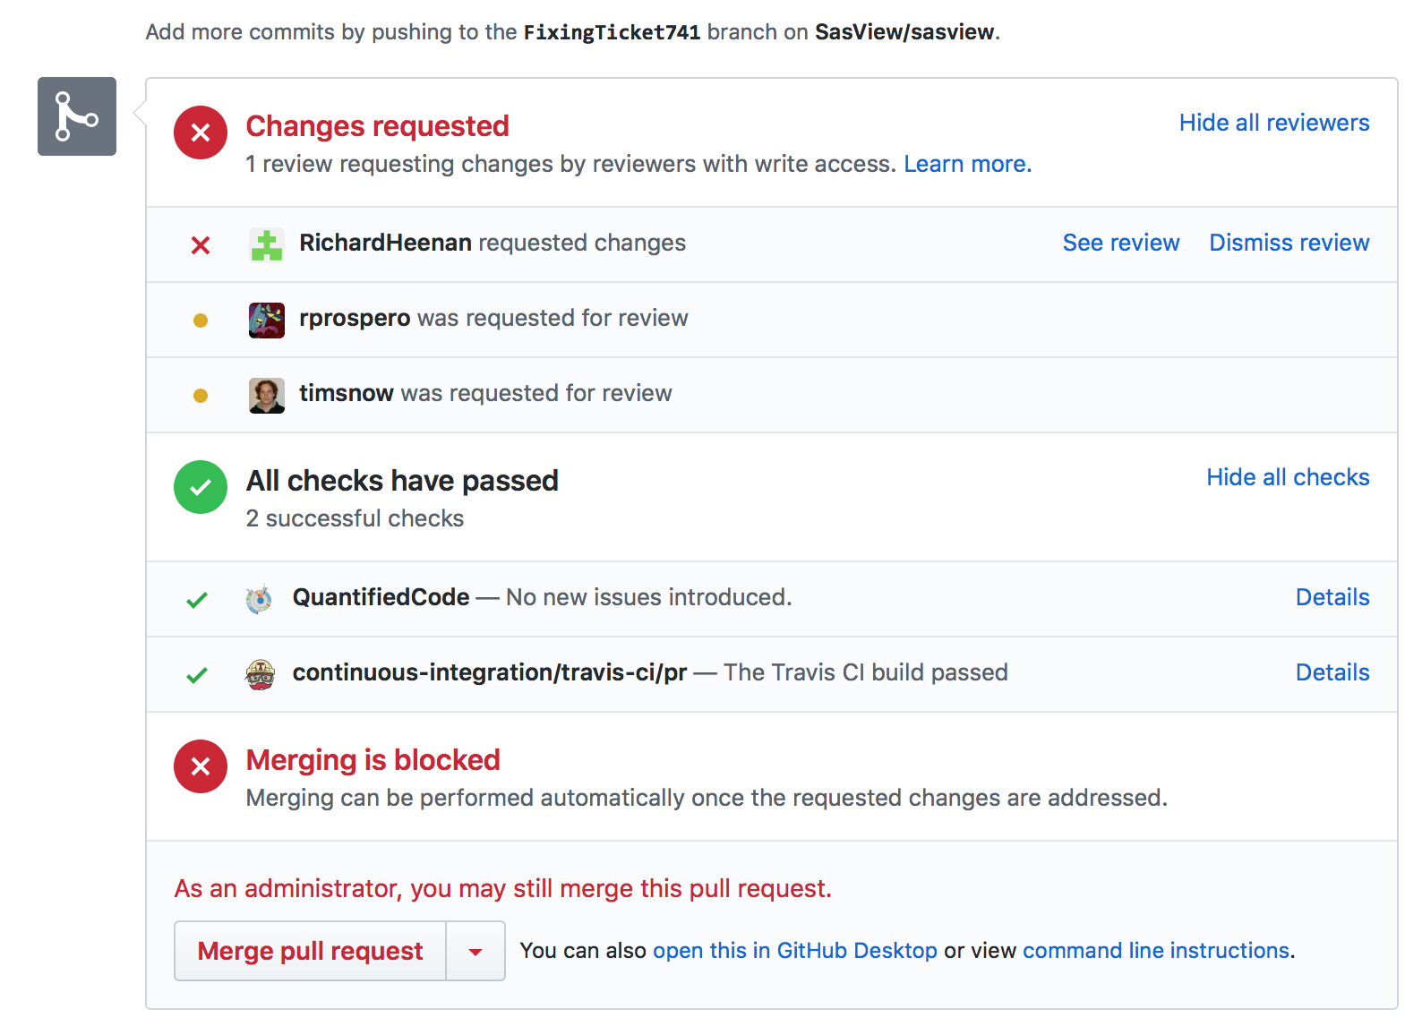
Development Model
www.sasview.org
Task and bug tracking. Developer wiki
trac.sasview.org
Code Hosting and some CI/testing of PRs
Automated Builds
build.sasview.org
Hosted by UT
Hosted by GitHub etc ...
Hosted by ESS

Slide 9
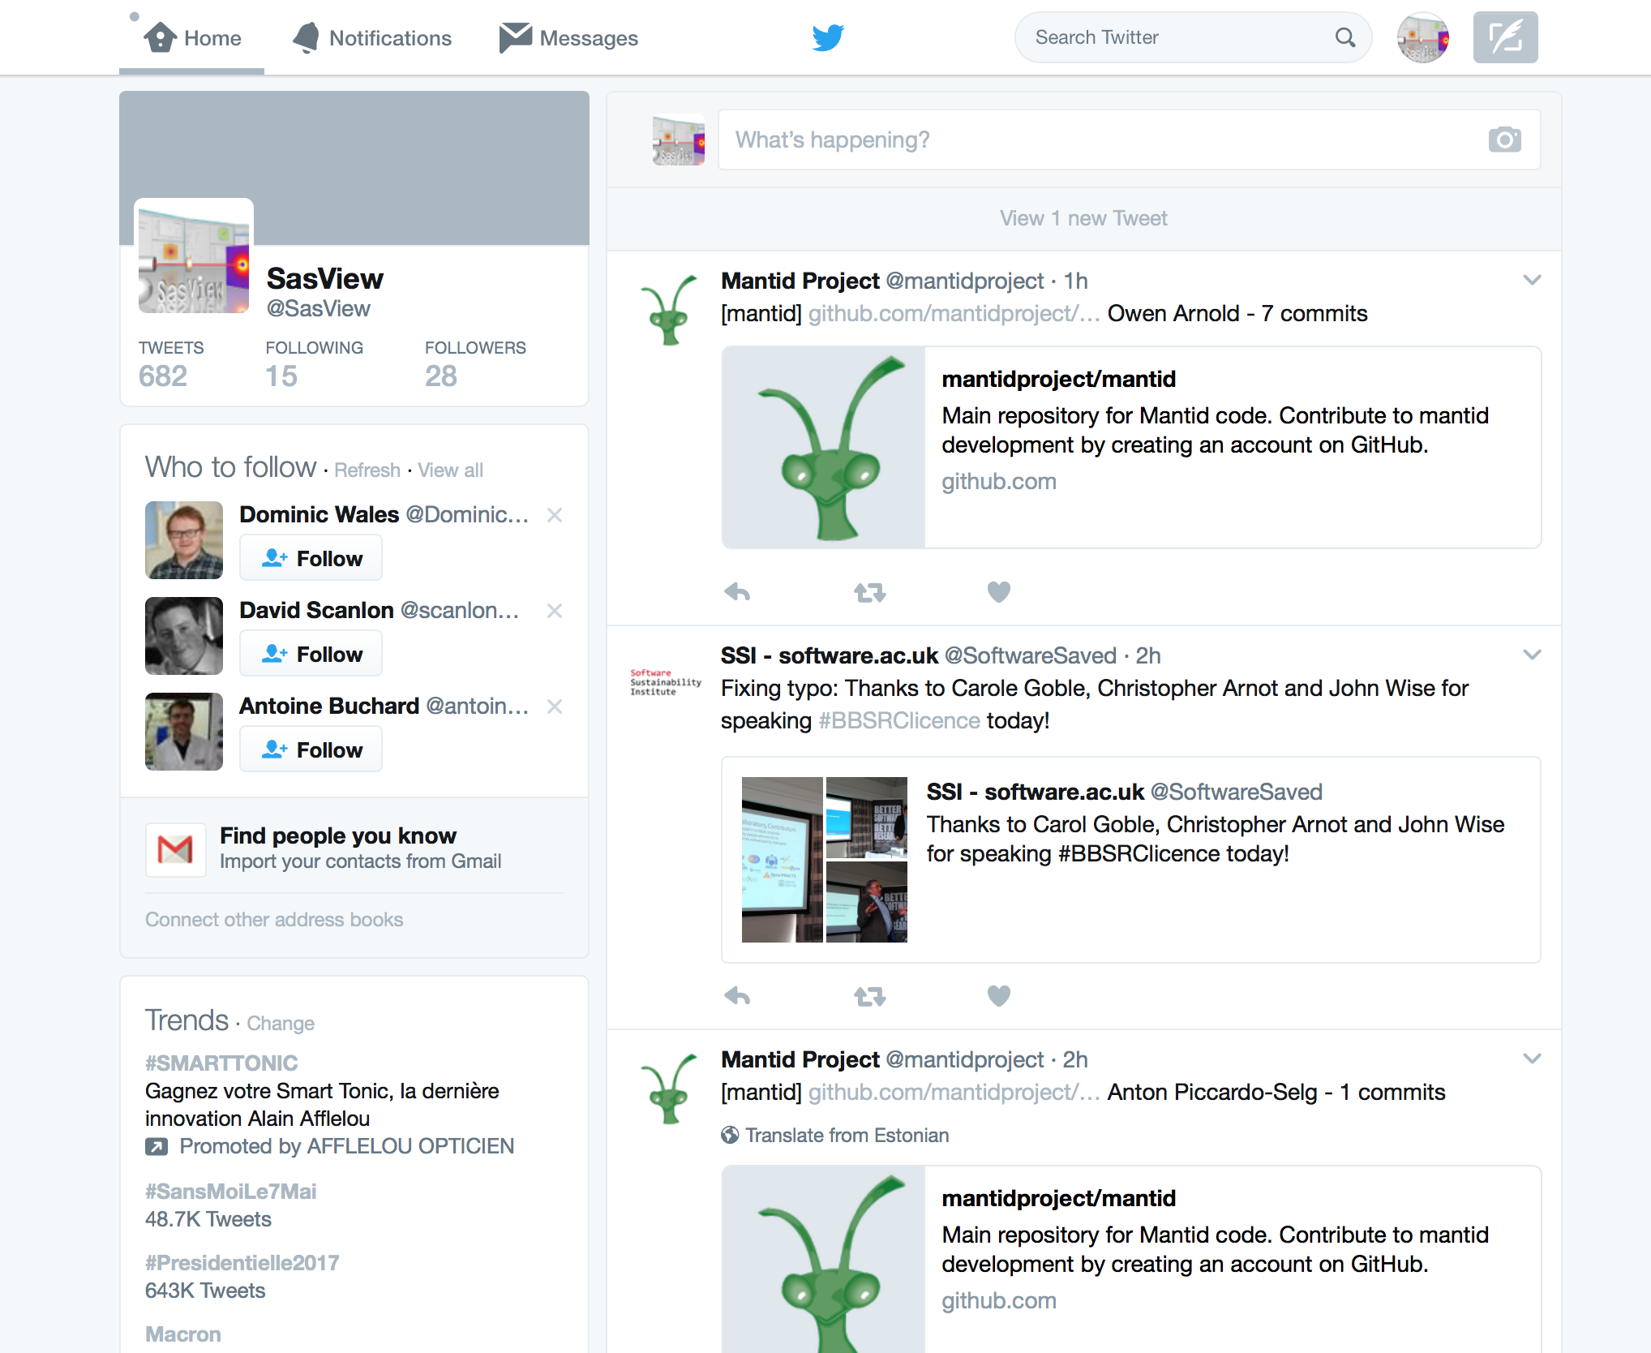
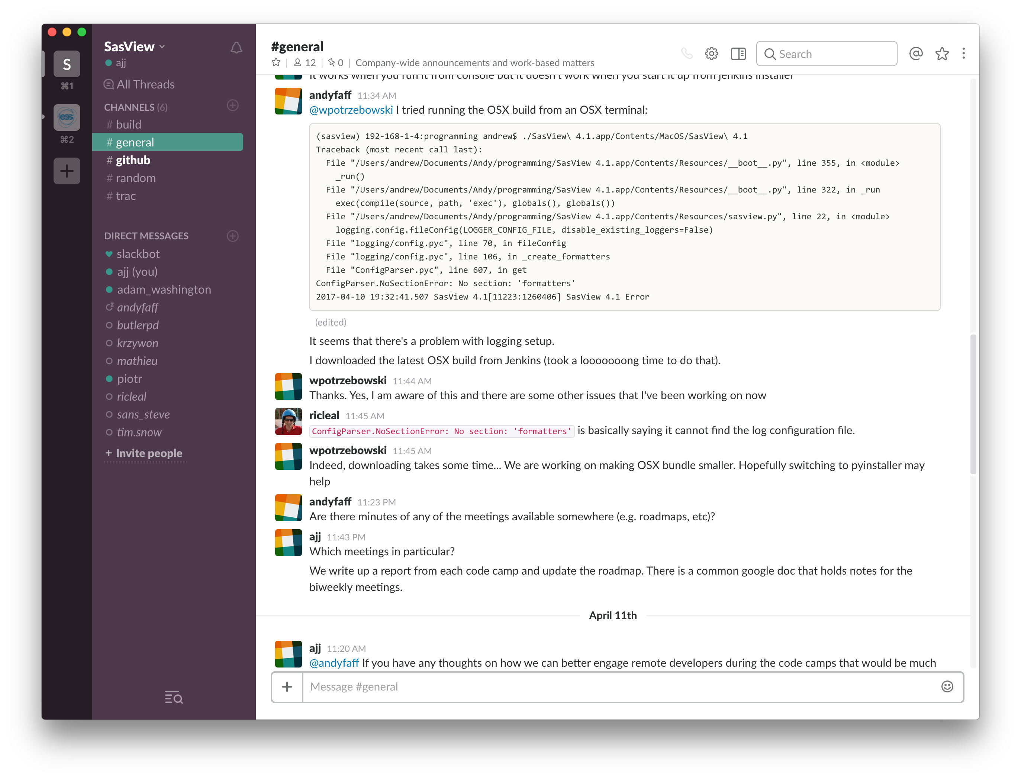
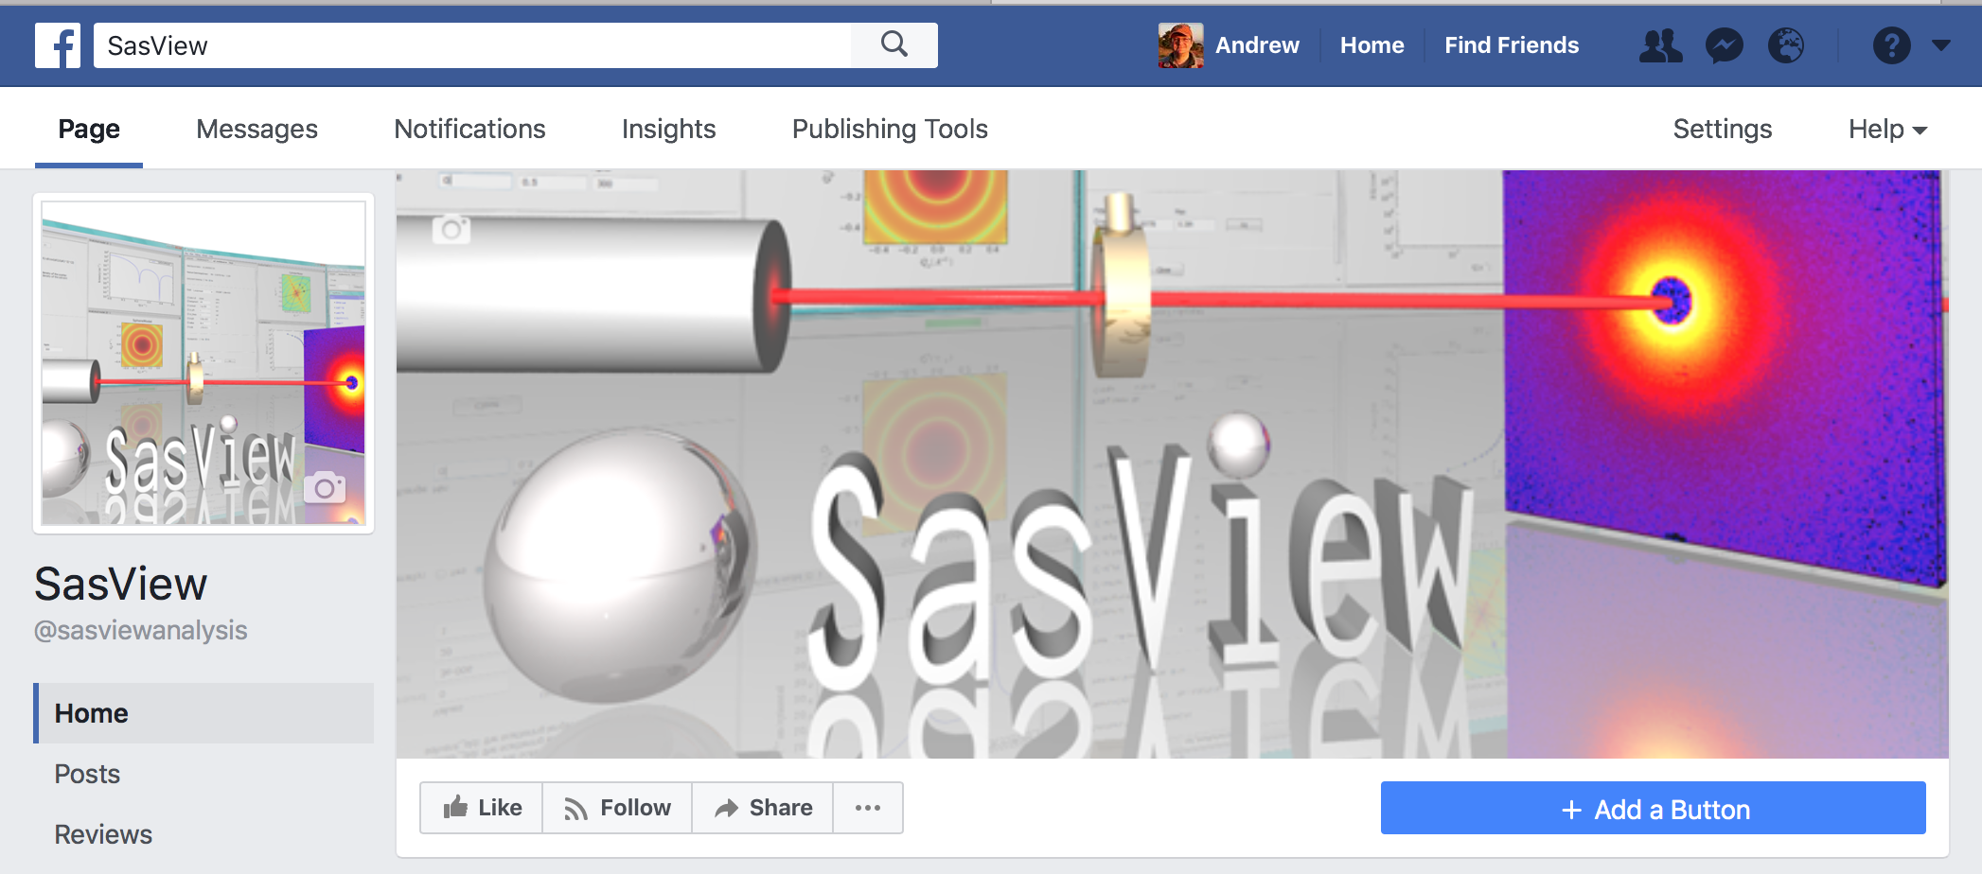
Development Model
Communications
Mailing lists
management@sasview.org
help@sasview.org
developers@sasview.org
users@sasview.org

Slide 10
Current Development Team
“Management” Team
Jurrian Bakker (TUD)
Wim Bouwman (TUD)
Miguel Gonzales (ILL)
Richard Heenan (STFC)
Dirk Honecker (ILL)
Paul Kienzle (NIST)
Jeff Kryzwon (NIST)
Ricardo Leal (ORNL)
David Mannicke (ANSTO)
Andrew Nelson (ANSTO)
Torben Nielsen (ESS)
Lewis O’Driscoll (STFC)
Steve Parnell (TUD)
Wojciech Potrzebowski (ESS)
Piotr Rozyczko (ESS)
Tim Snow (Diamond)
Adam Washington (STFC)
Paul Butler (NIST)
Mathieu Doucet (ORNL)
Andrew Jackson (ESS)
Steve King (STFC)
Code Camp VI hosted by ESRF & ILL – April 4th – 11th 2017
and thanks to the many previous contributors, particularly Jae Hie Cho and Alina Gervaise

Slide 11
What Can SasView Do?

Slide 12
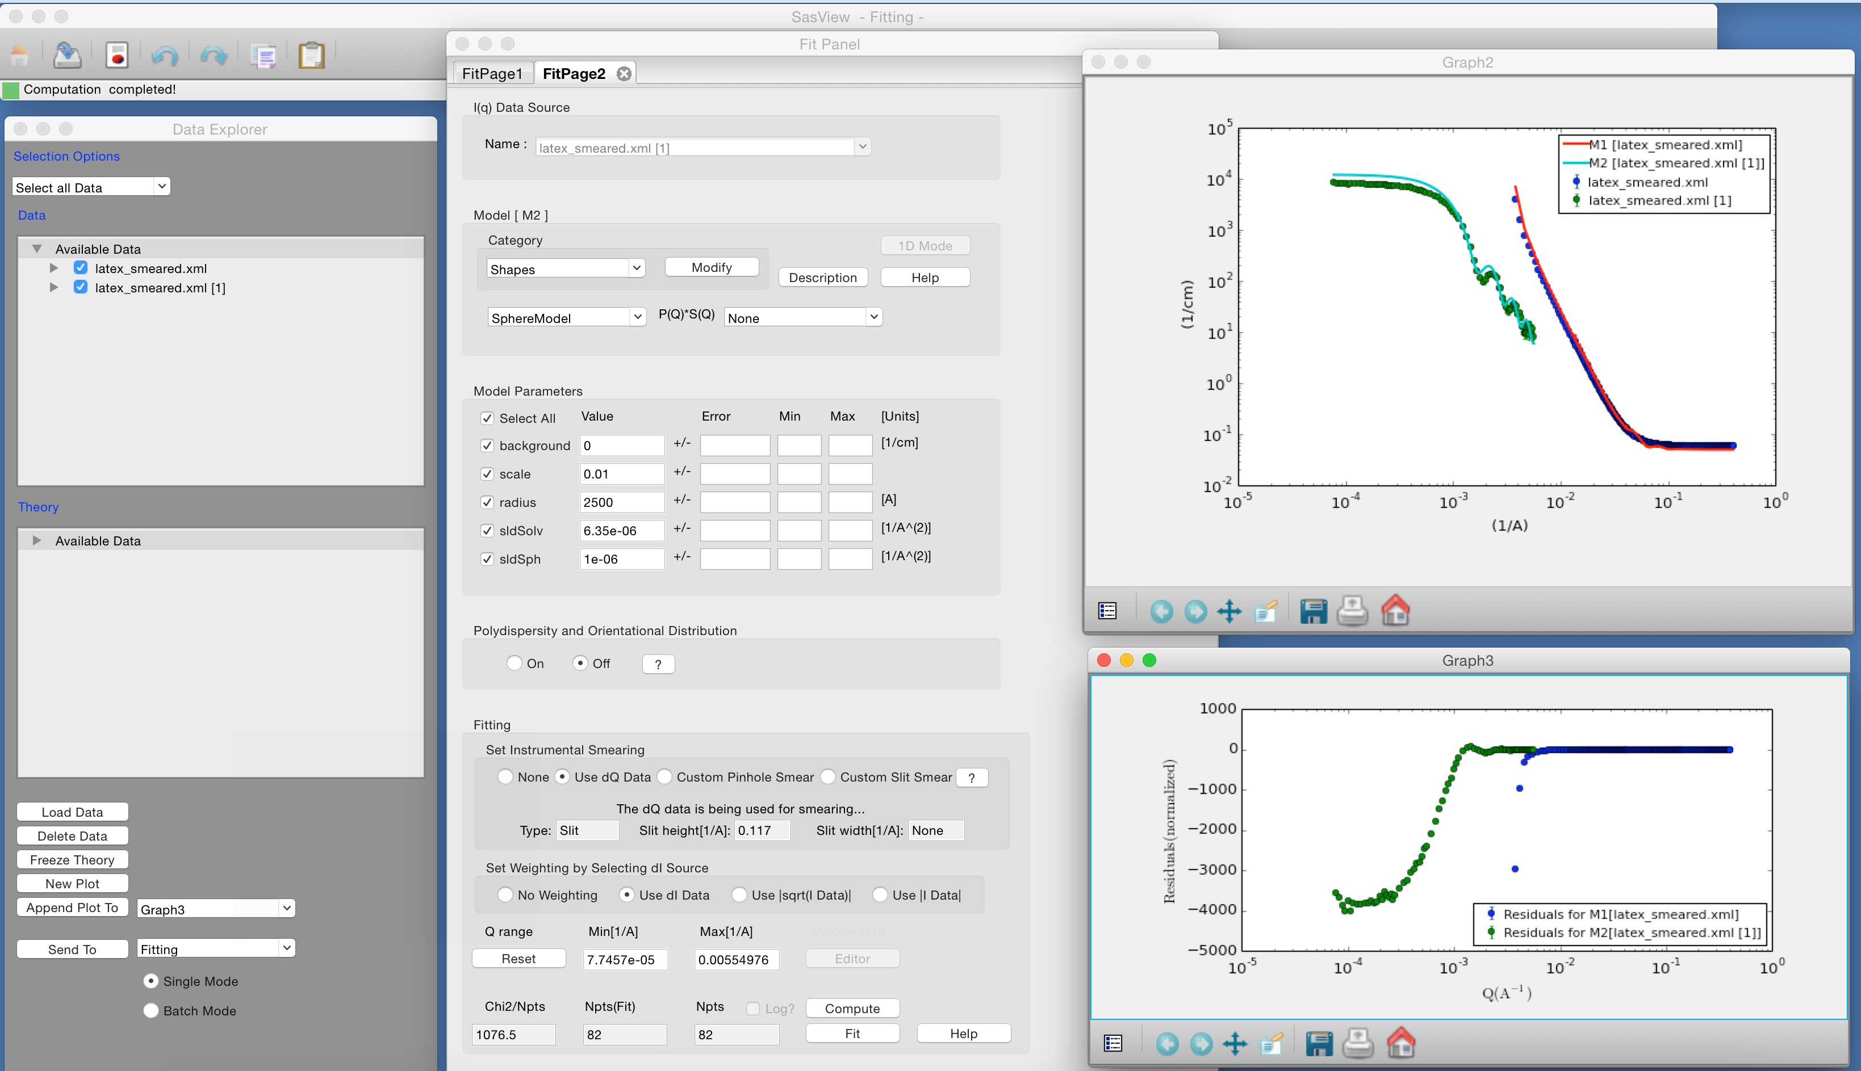
1D Analysis
Data management
Common data formats supported, including NXCansas & cansas1D
Wide choice of built-in models (> 70)
P(Q), S(Q) & P(Q)*S(Q)
Simultaneous fitting
Analysis Tool Choice
&
Plotting
Generic parameter polydispersity
Choice of distribution and distribution parameters
Resolution smearing (pinhole and slit)
Automatically from data or provide parameters

Slide 13
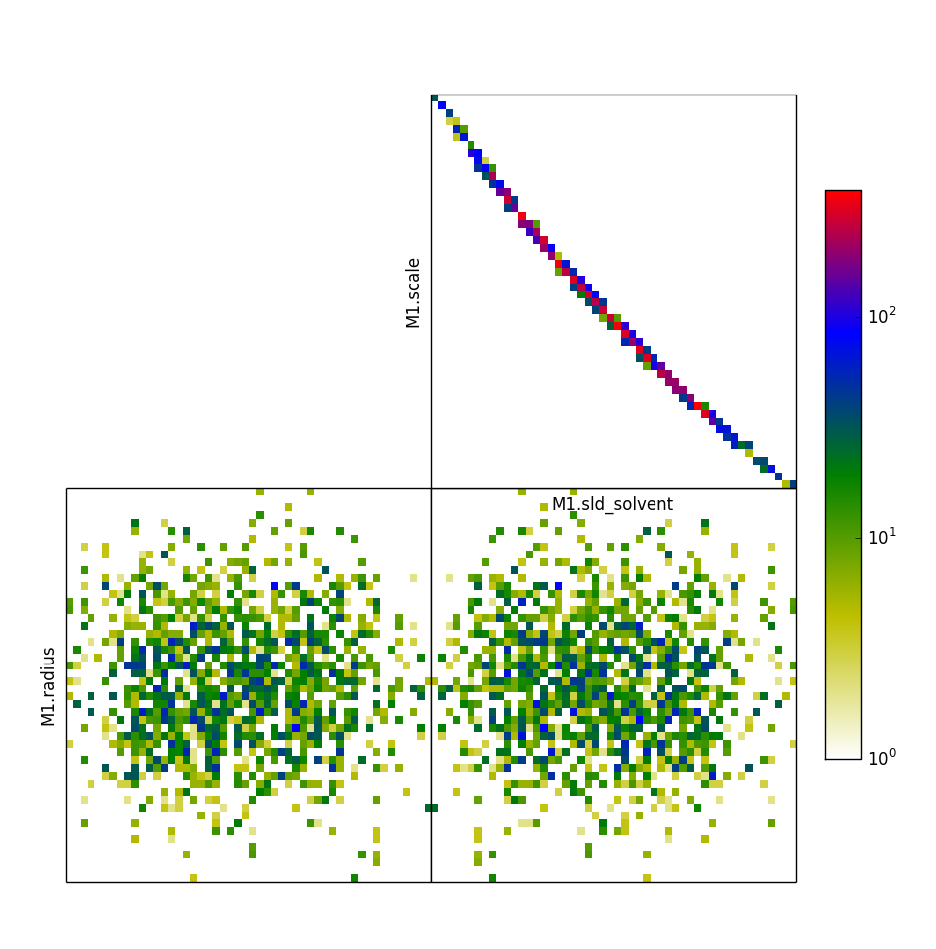
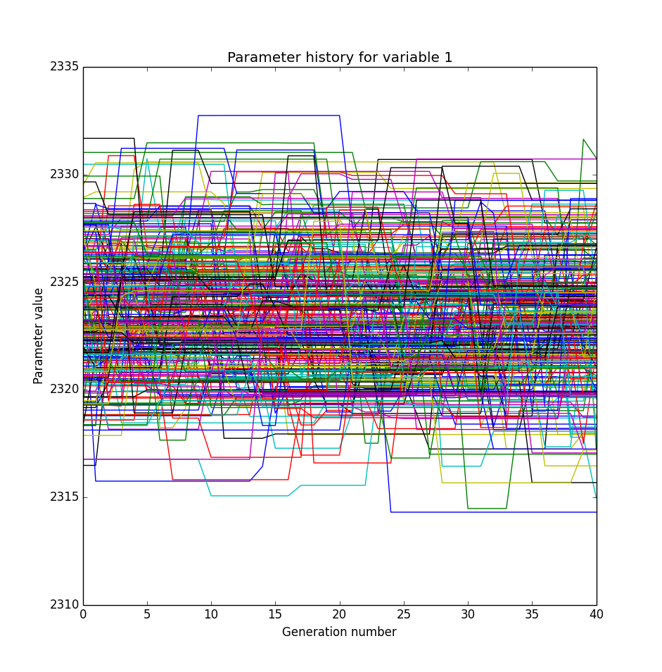
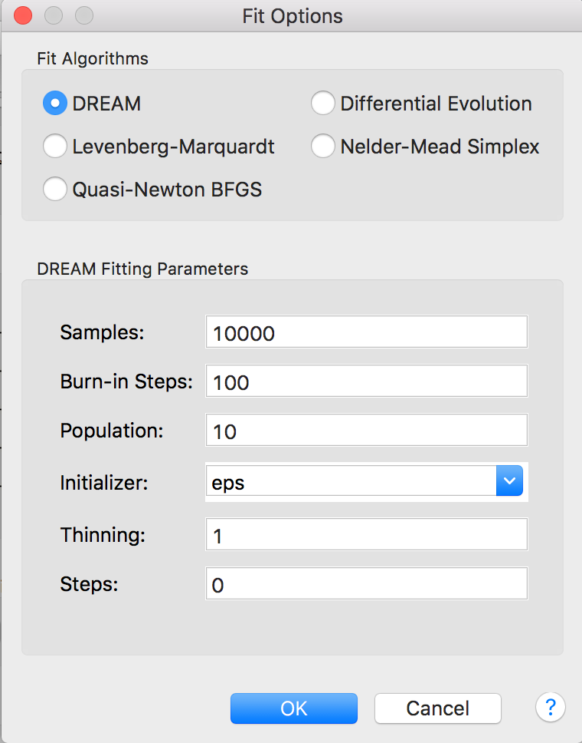
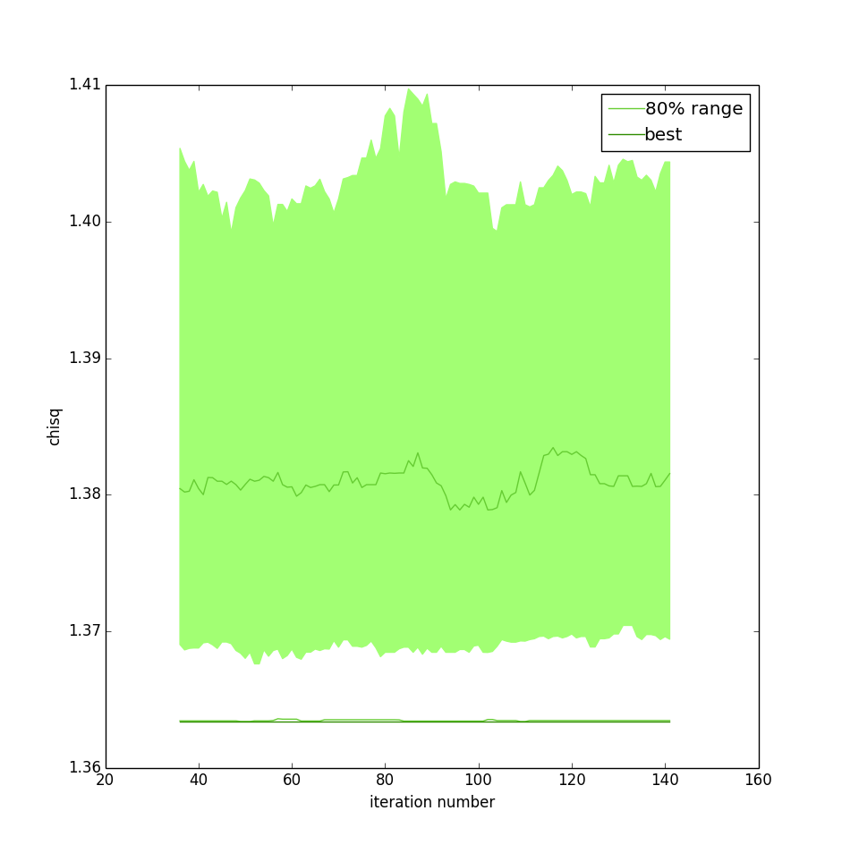
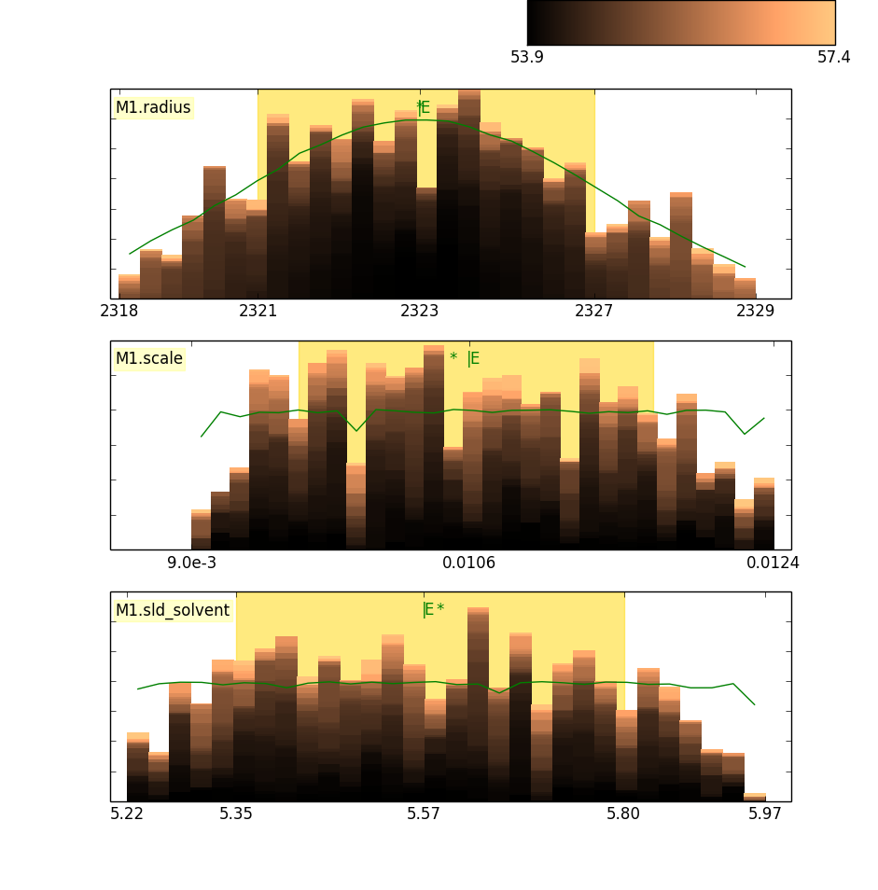
Fitting Algorithms
Uses bumps package from P. Kienzle

Slide 14
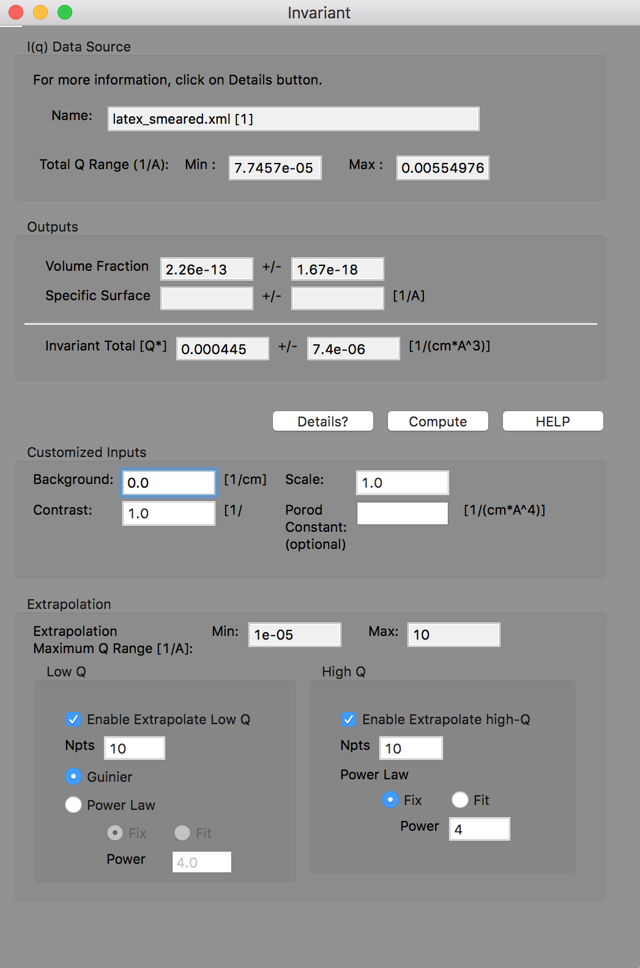
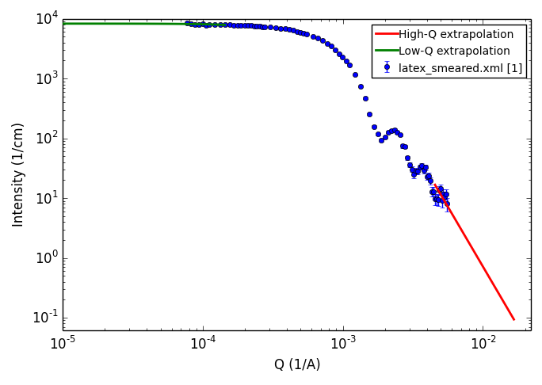
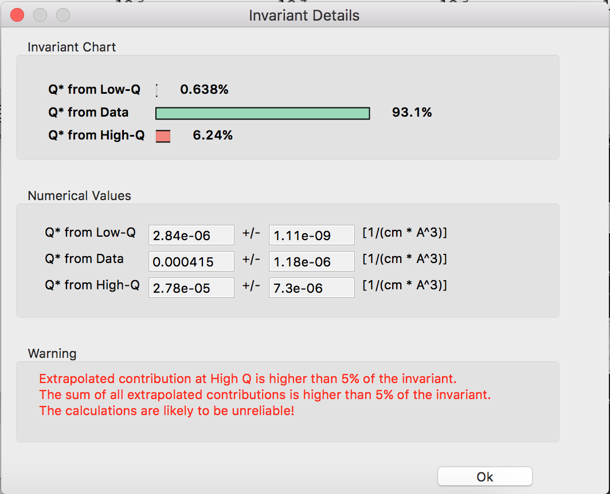
Invariant Calculation

Slide 15
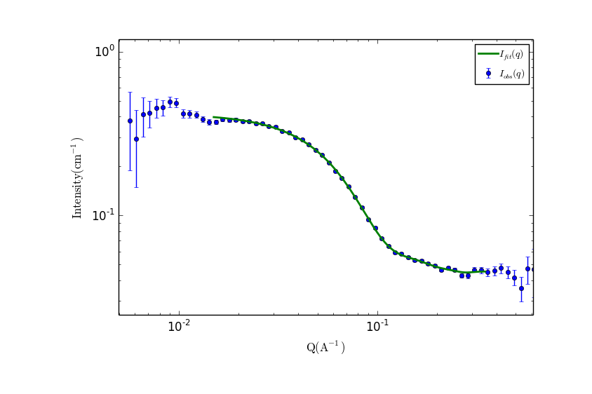
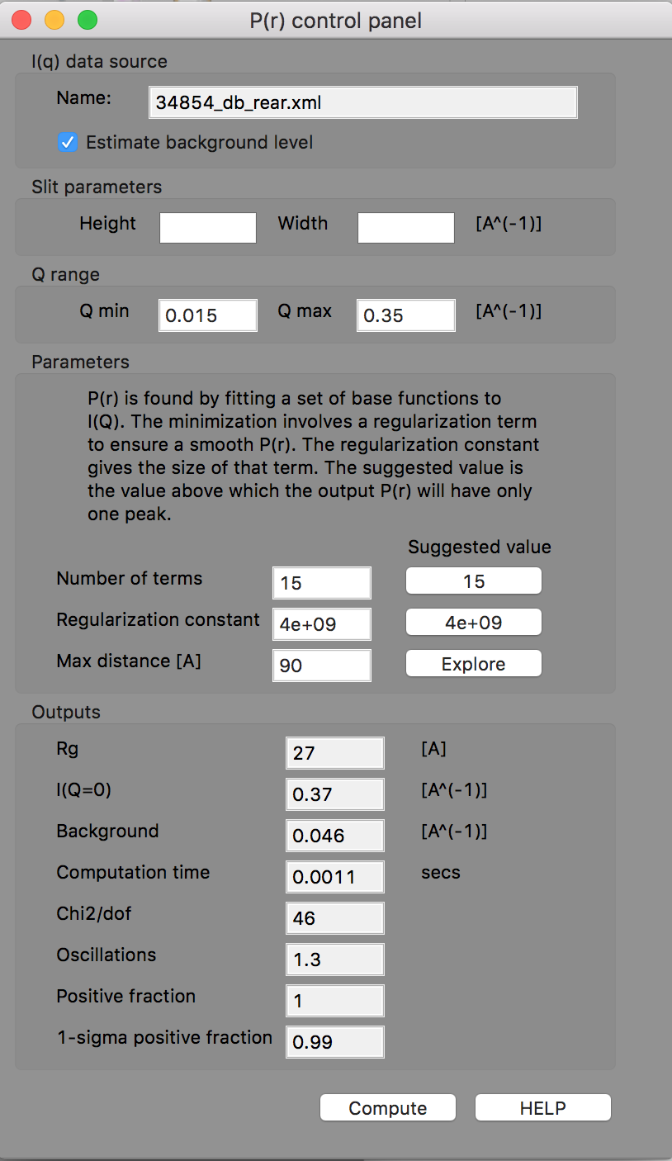
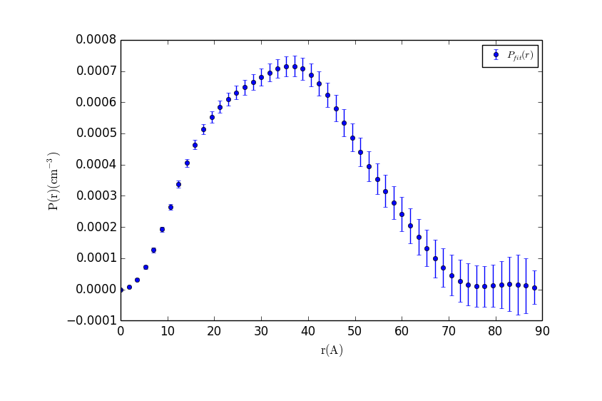
P(r) Inversion

Slide 16
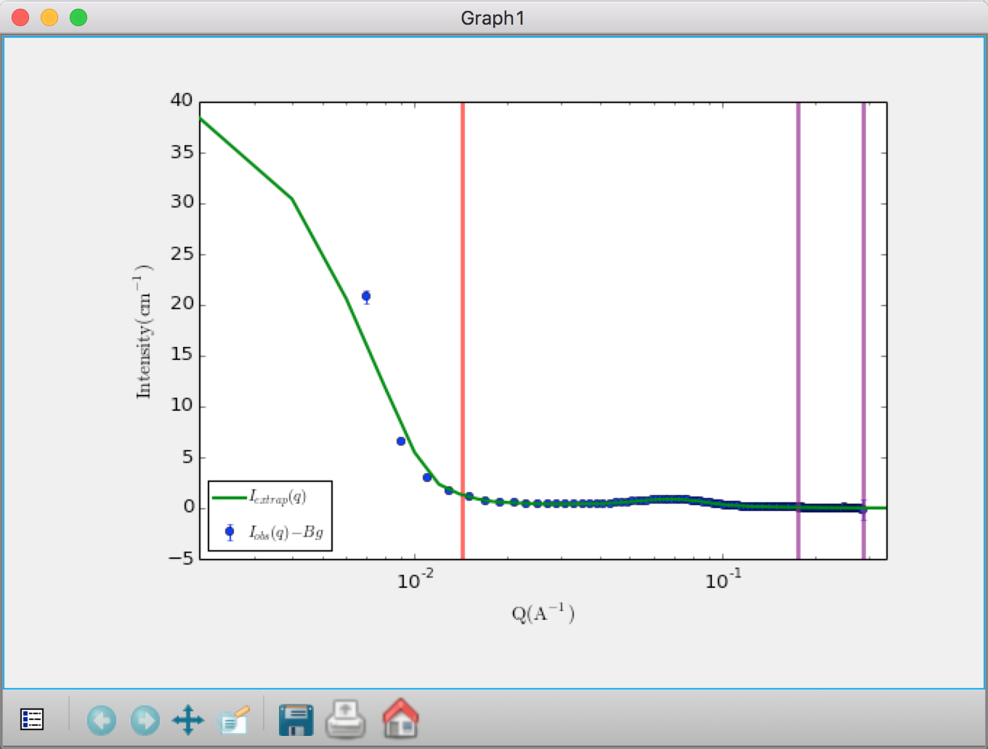
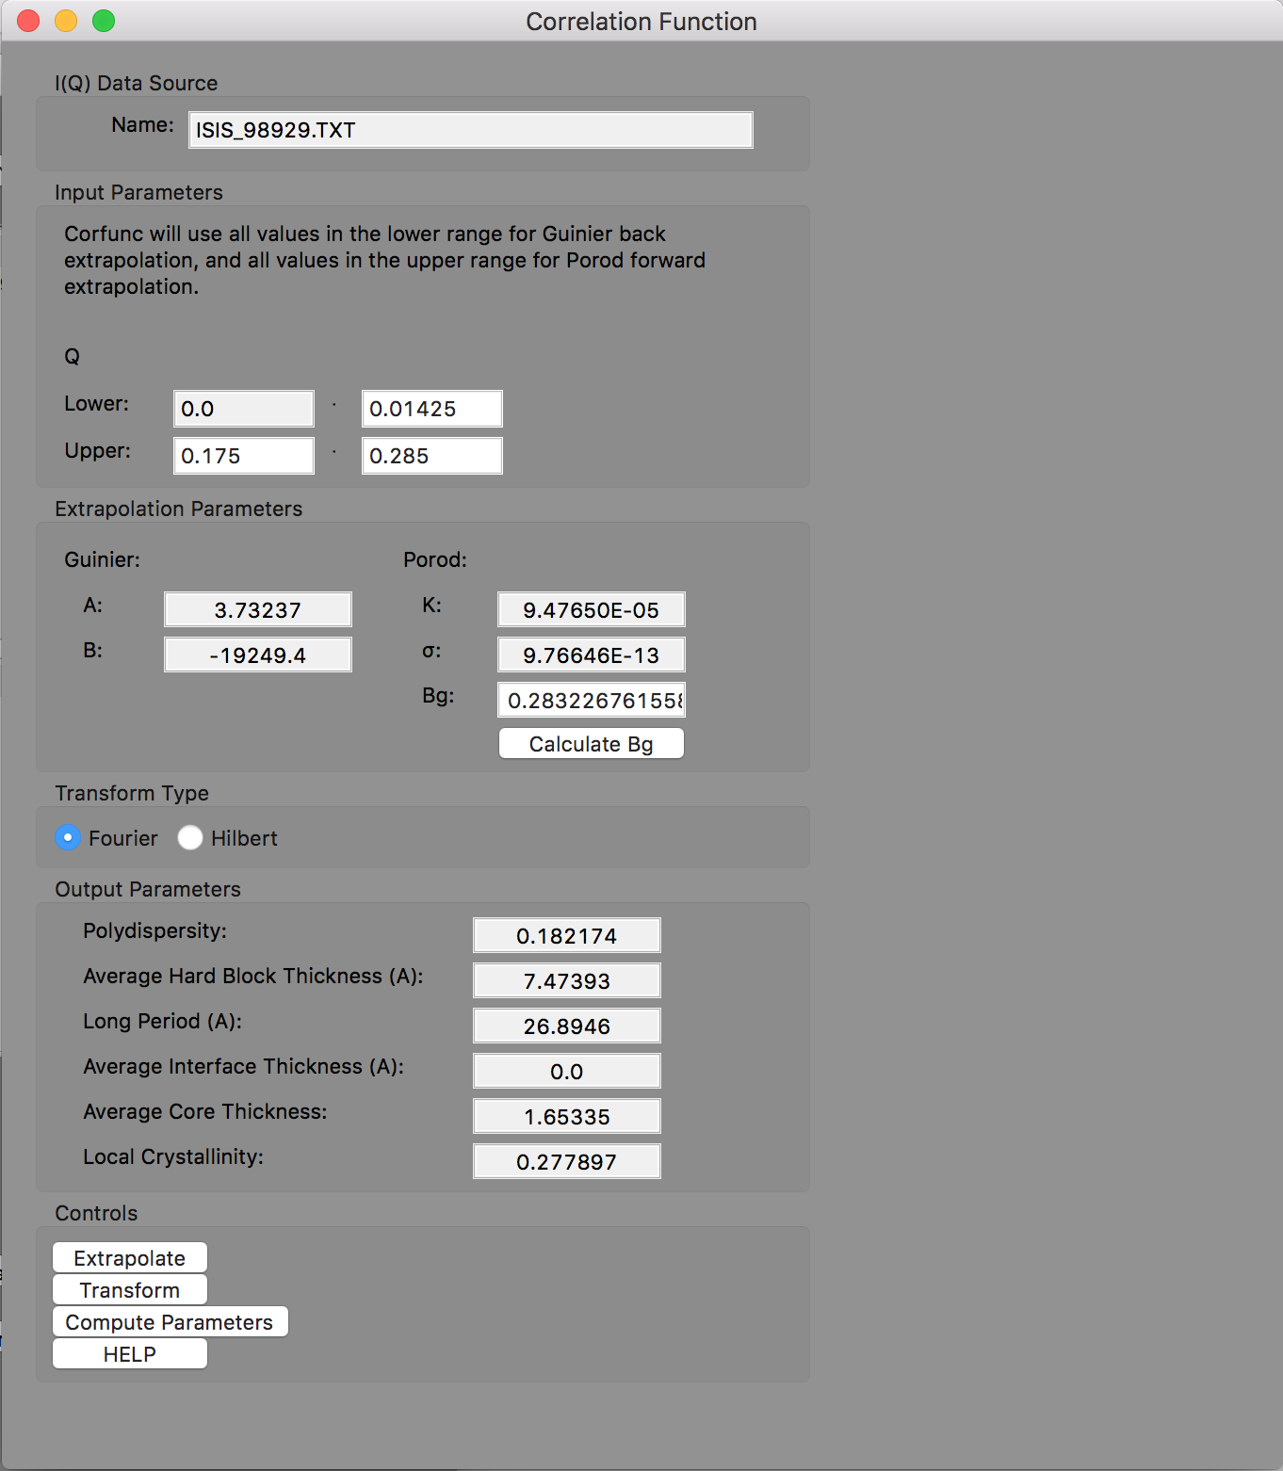
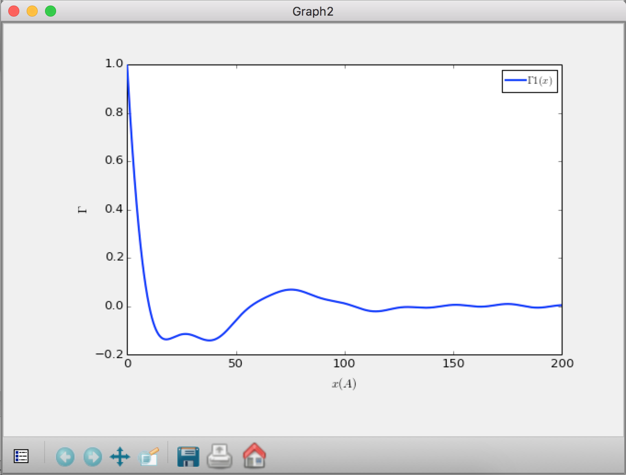
Correlation Function Analysis (new!)

Slide 17
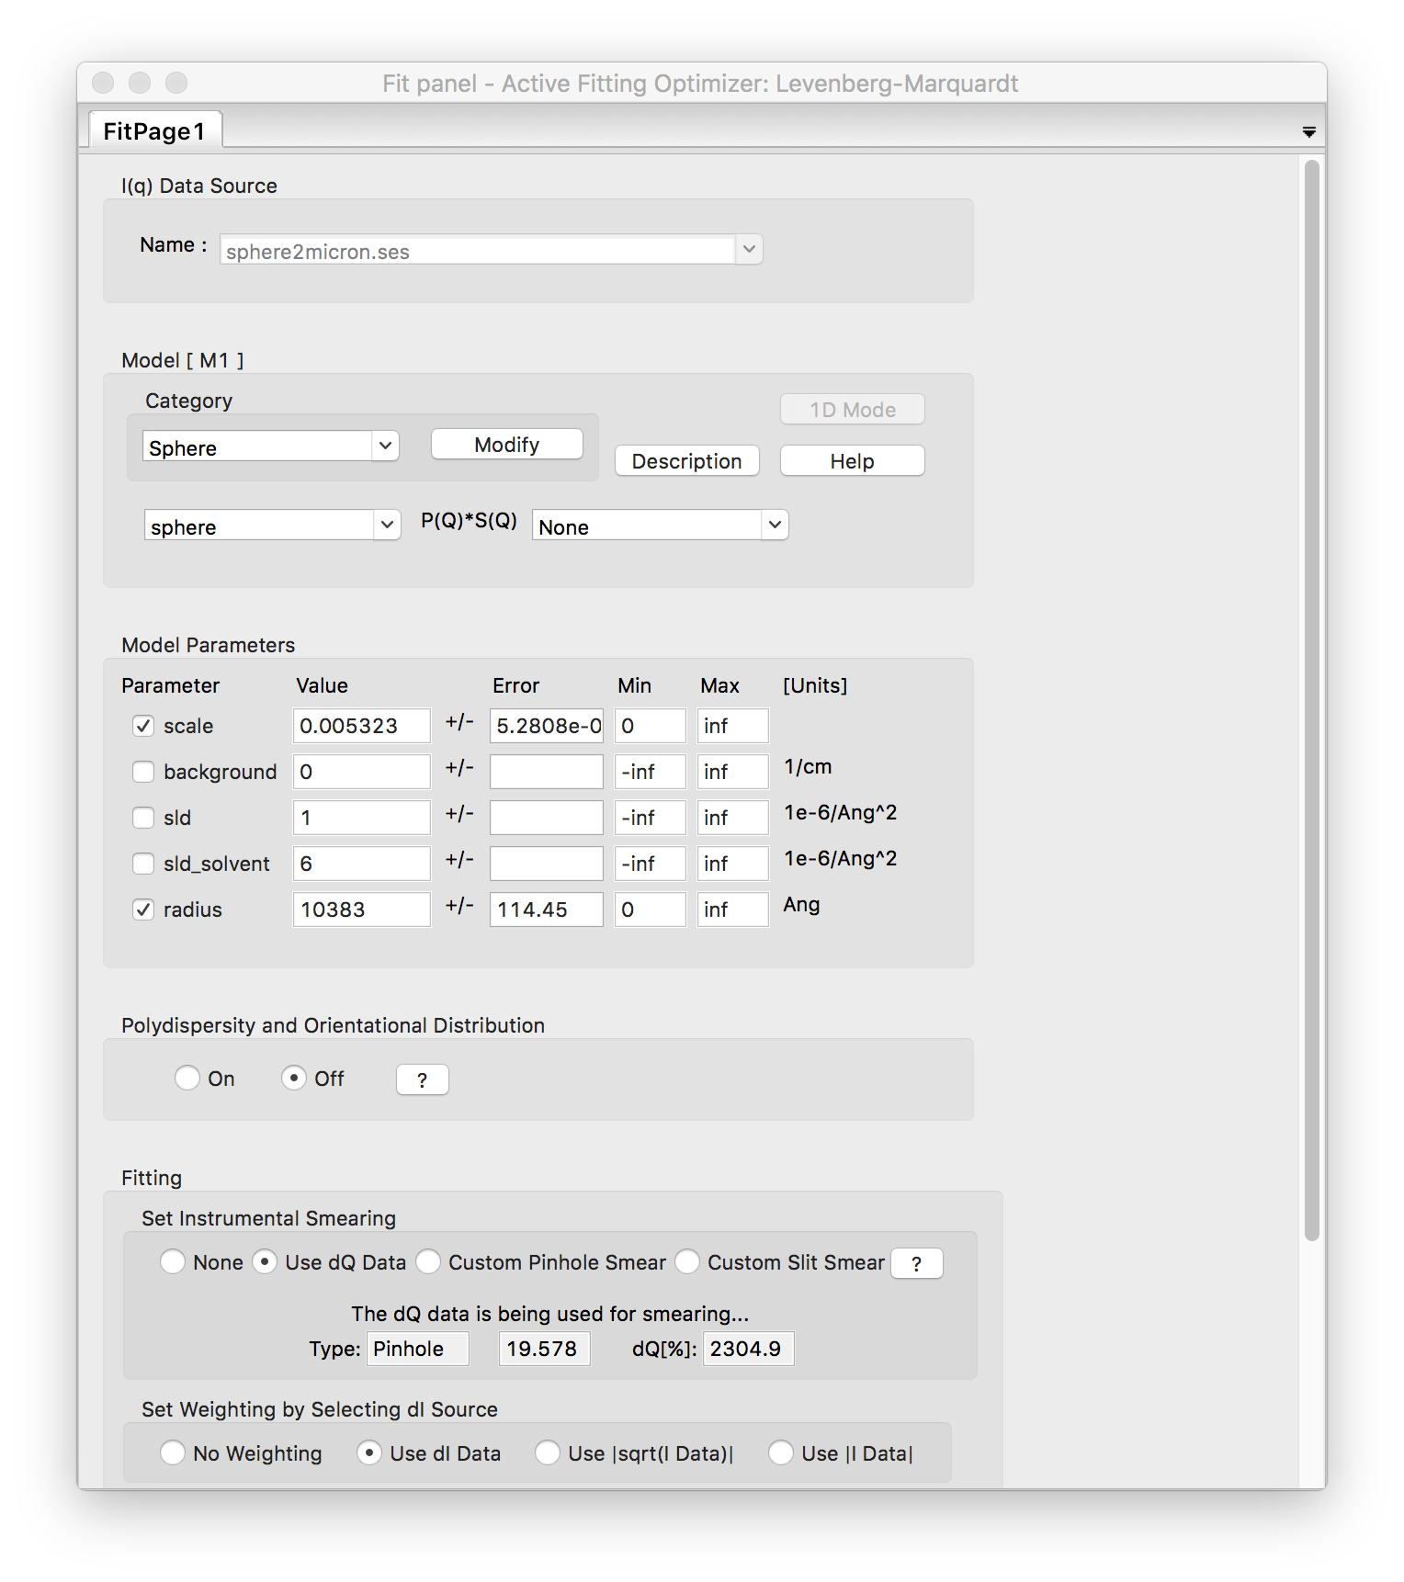
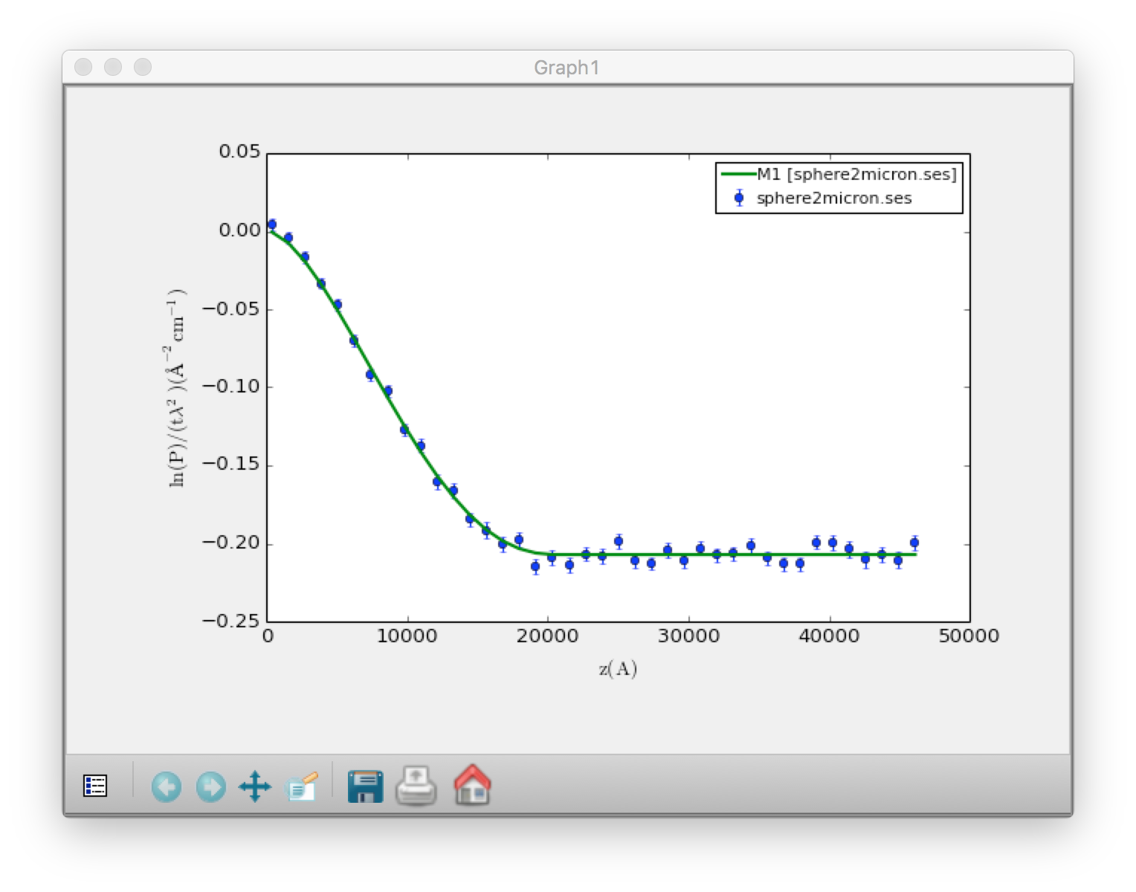
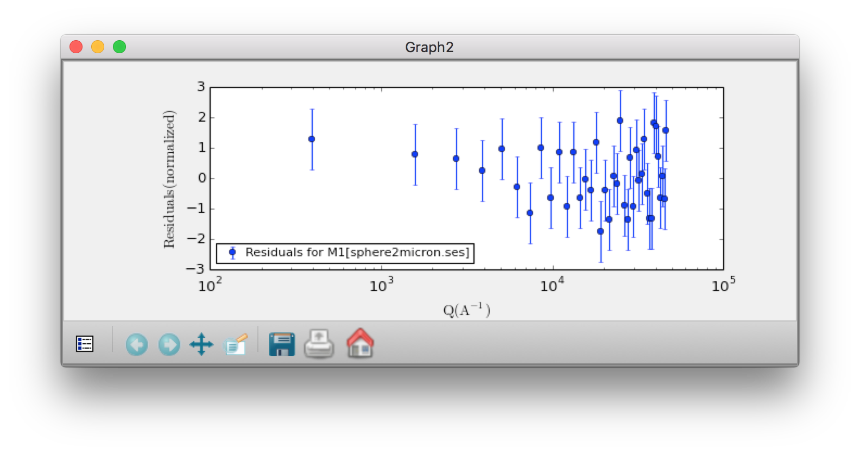
SESANS Analysis
Automatic Hankel Transform of SANS models

Slide 18
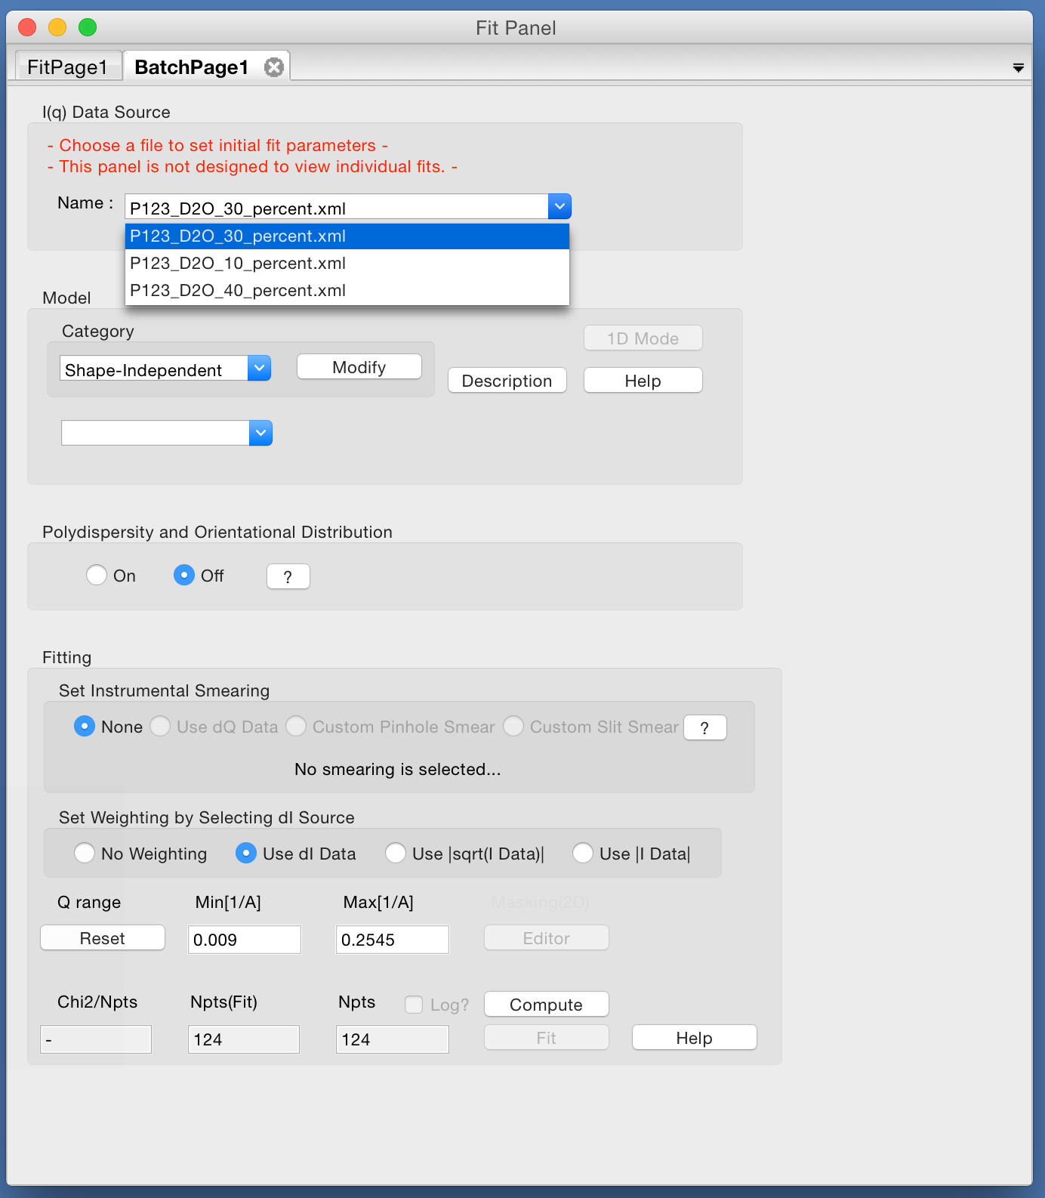
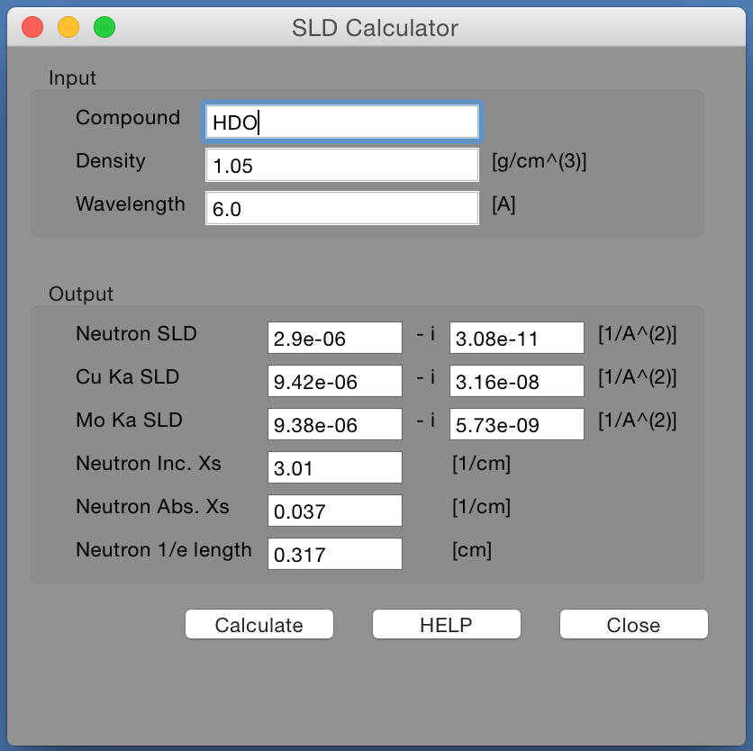
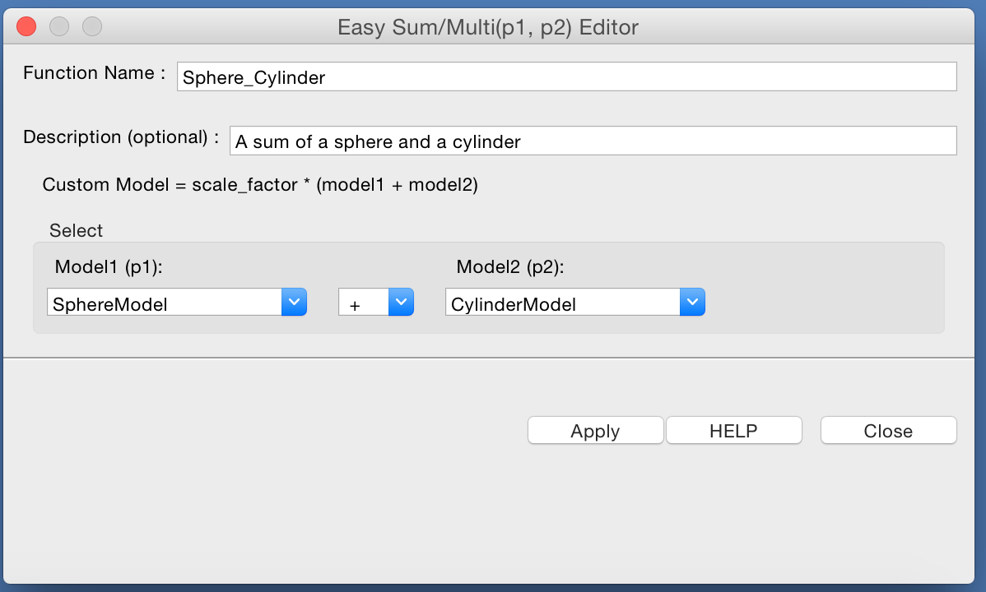
Other Features
Batch fitting …
SLD Calculator …
Sum & Multiplication of Models …

Slide 19
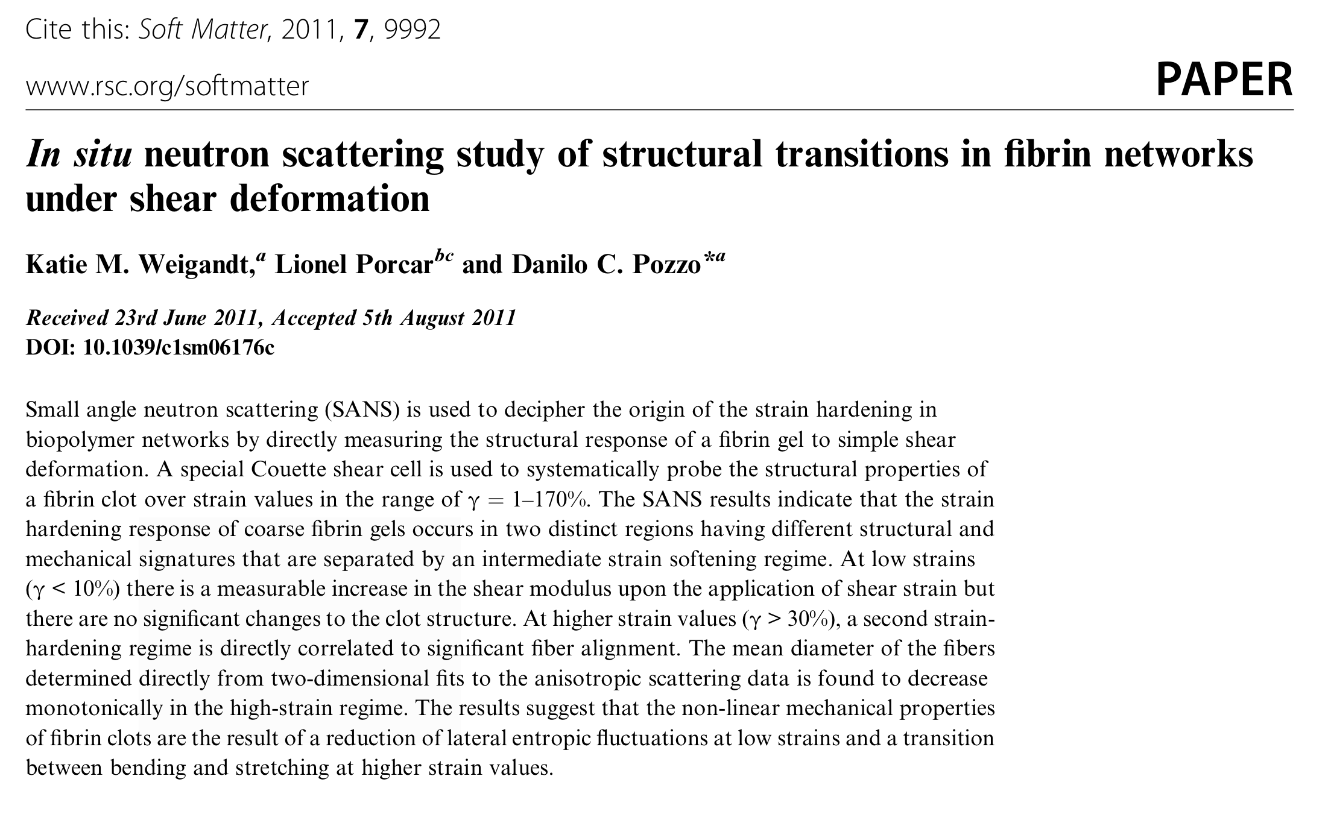
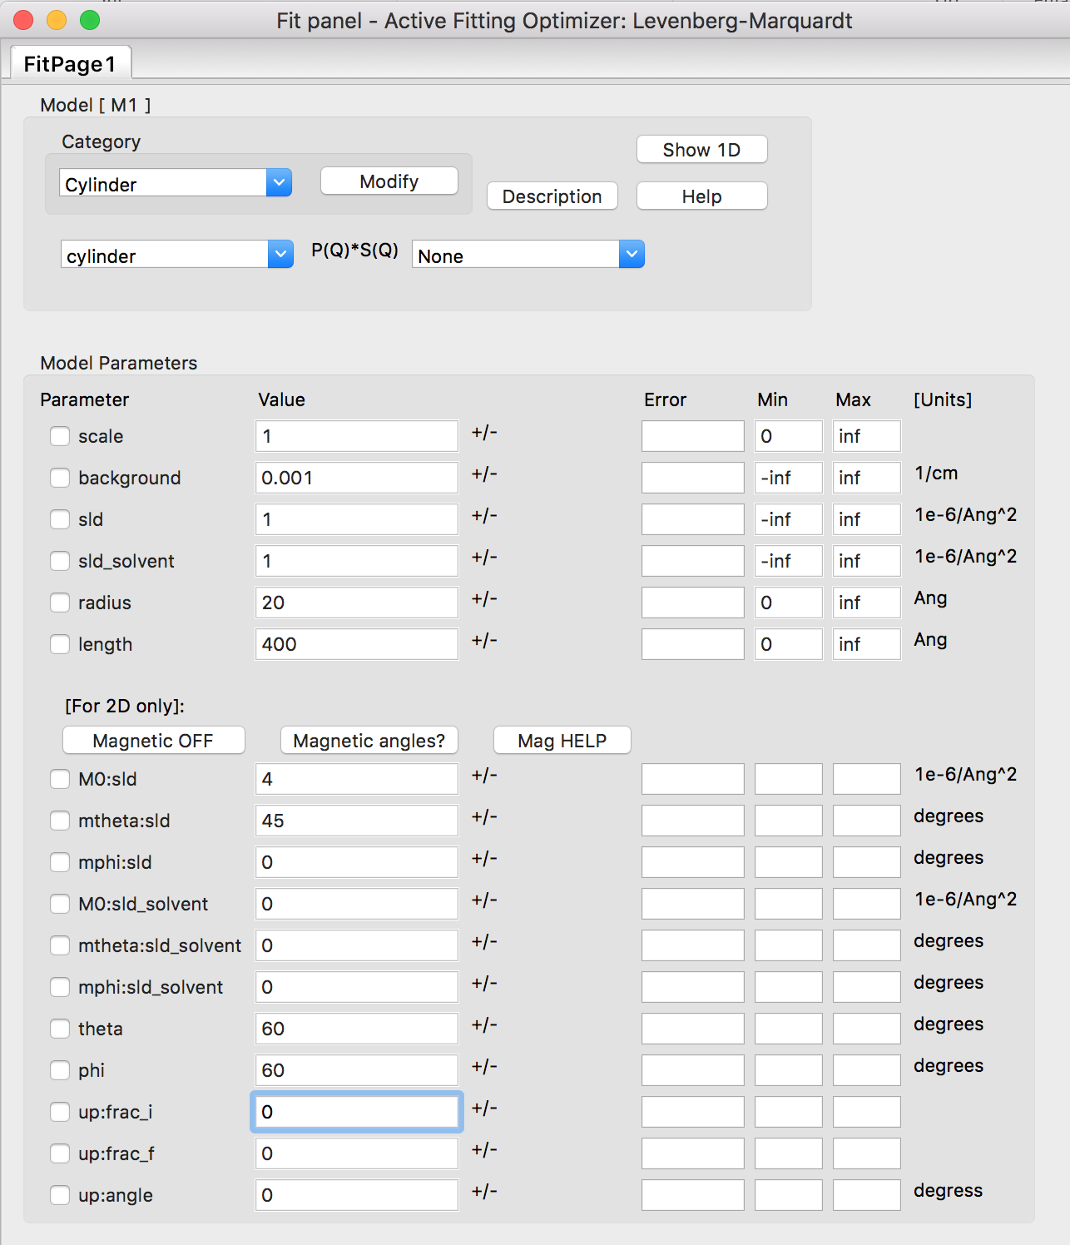
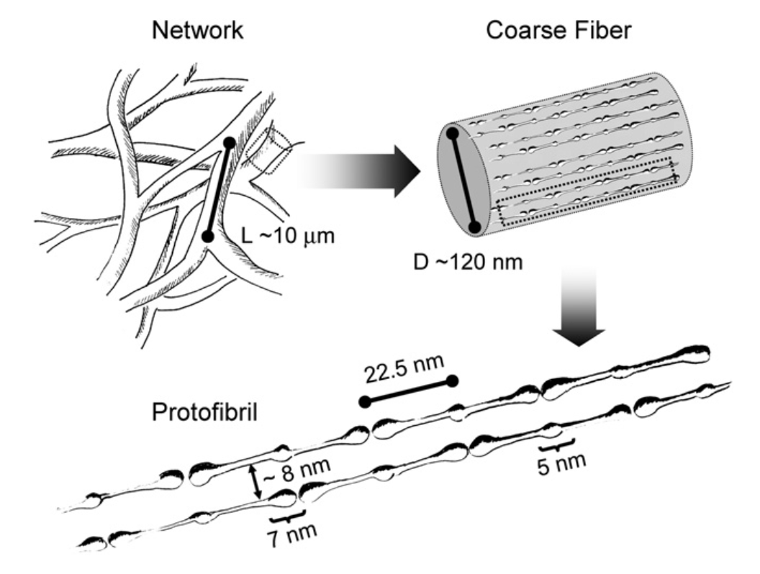
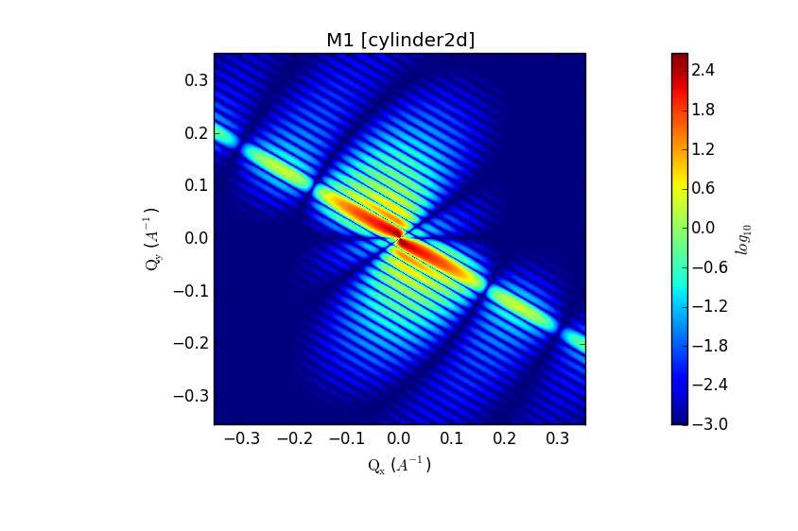
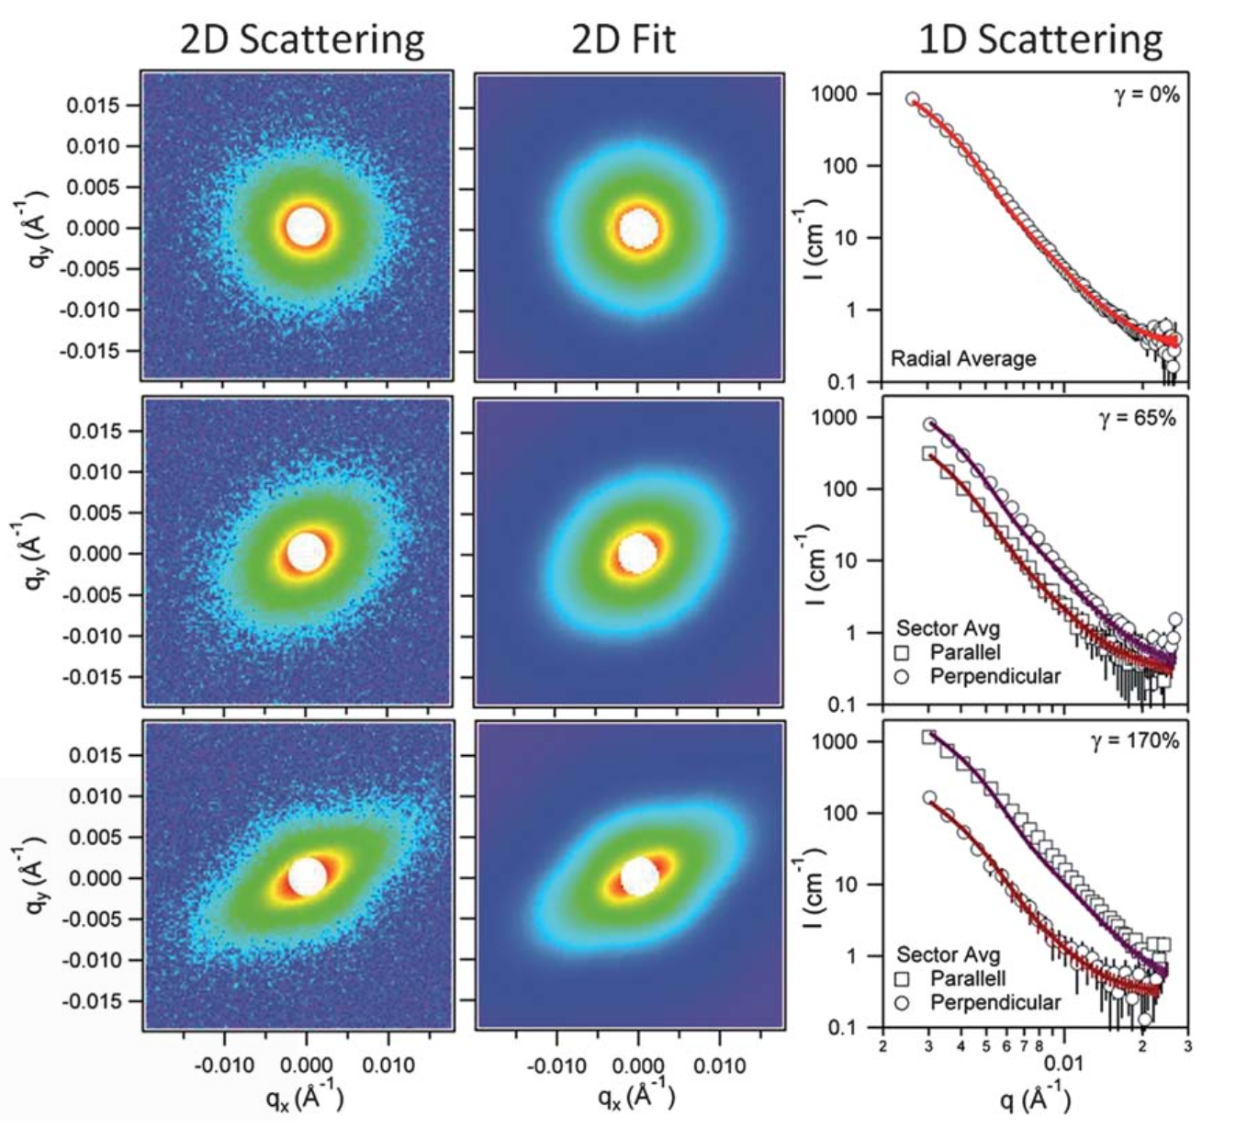
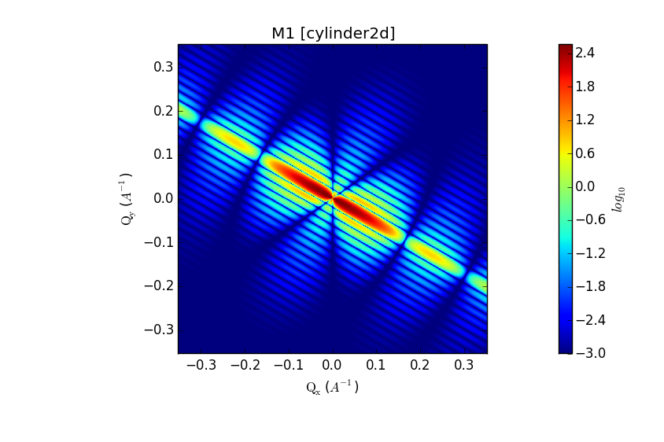
2D Modelling
Oriented systems & Magnetic Scattering
NSF
SF

Slide 20
Creating Models
Old Way
Write a model in python and drop it in plugin folder
Easy but no polydispersity available
Write a model in C and incorporate into SasView
Difficult and need to recompile whole programme
New Way
Models distributed in separate package (sasmodels)
separation of models from GUI
simpler addition of models by users
speed! GPU and parallel processing when using C
All models work the same
Write in python and/or C and drop in plugin folder

Slide 21
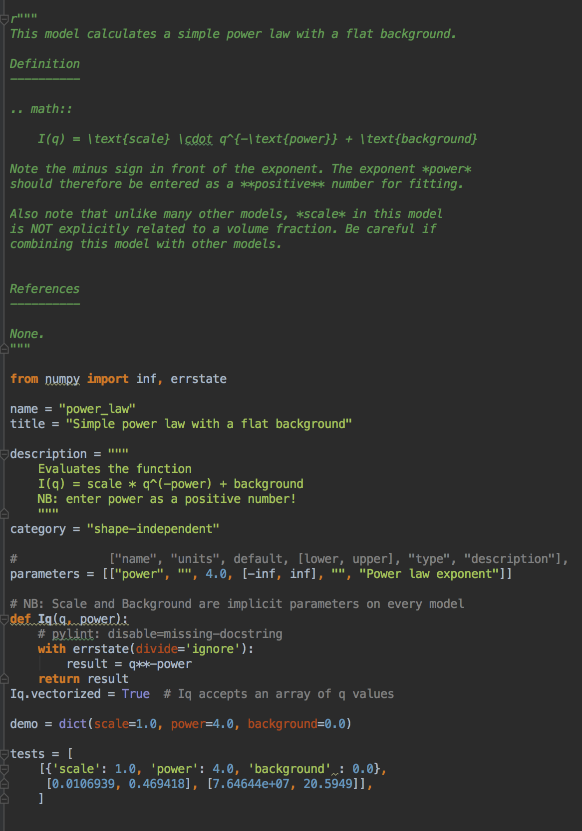
Creating Models
Pure Python
Documentation
Description
Parameters
Calculation
Tests

Slide 22
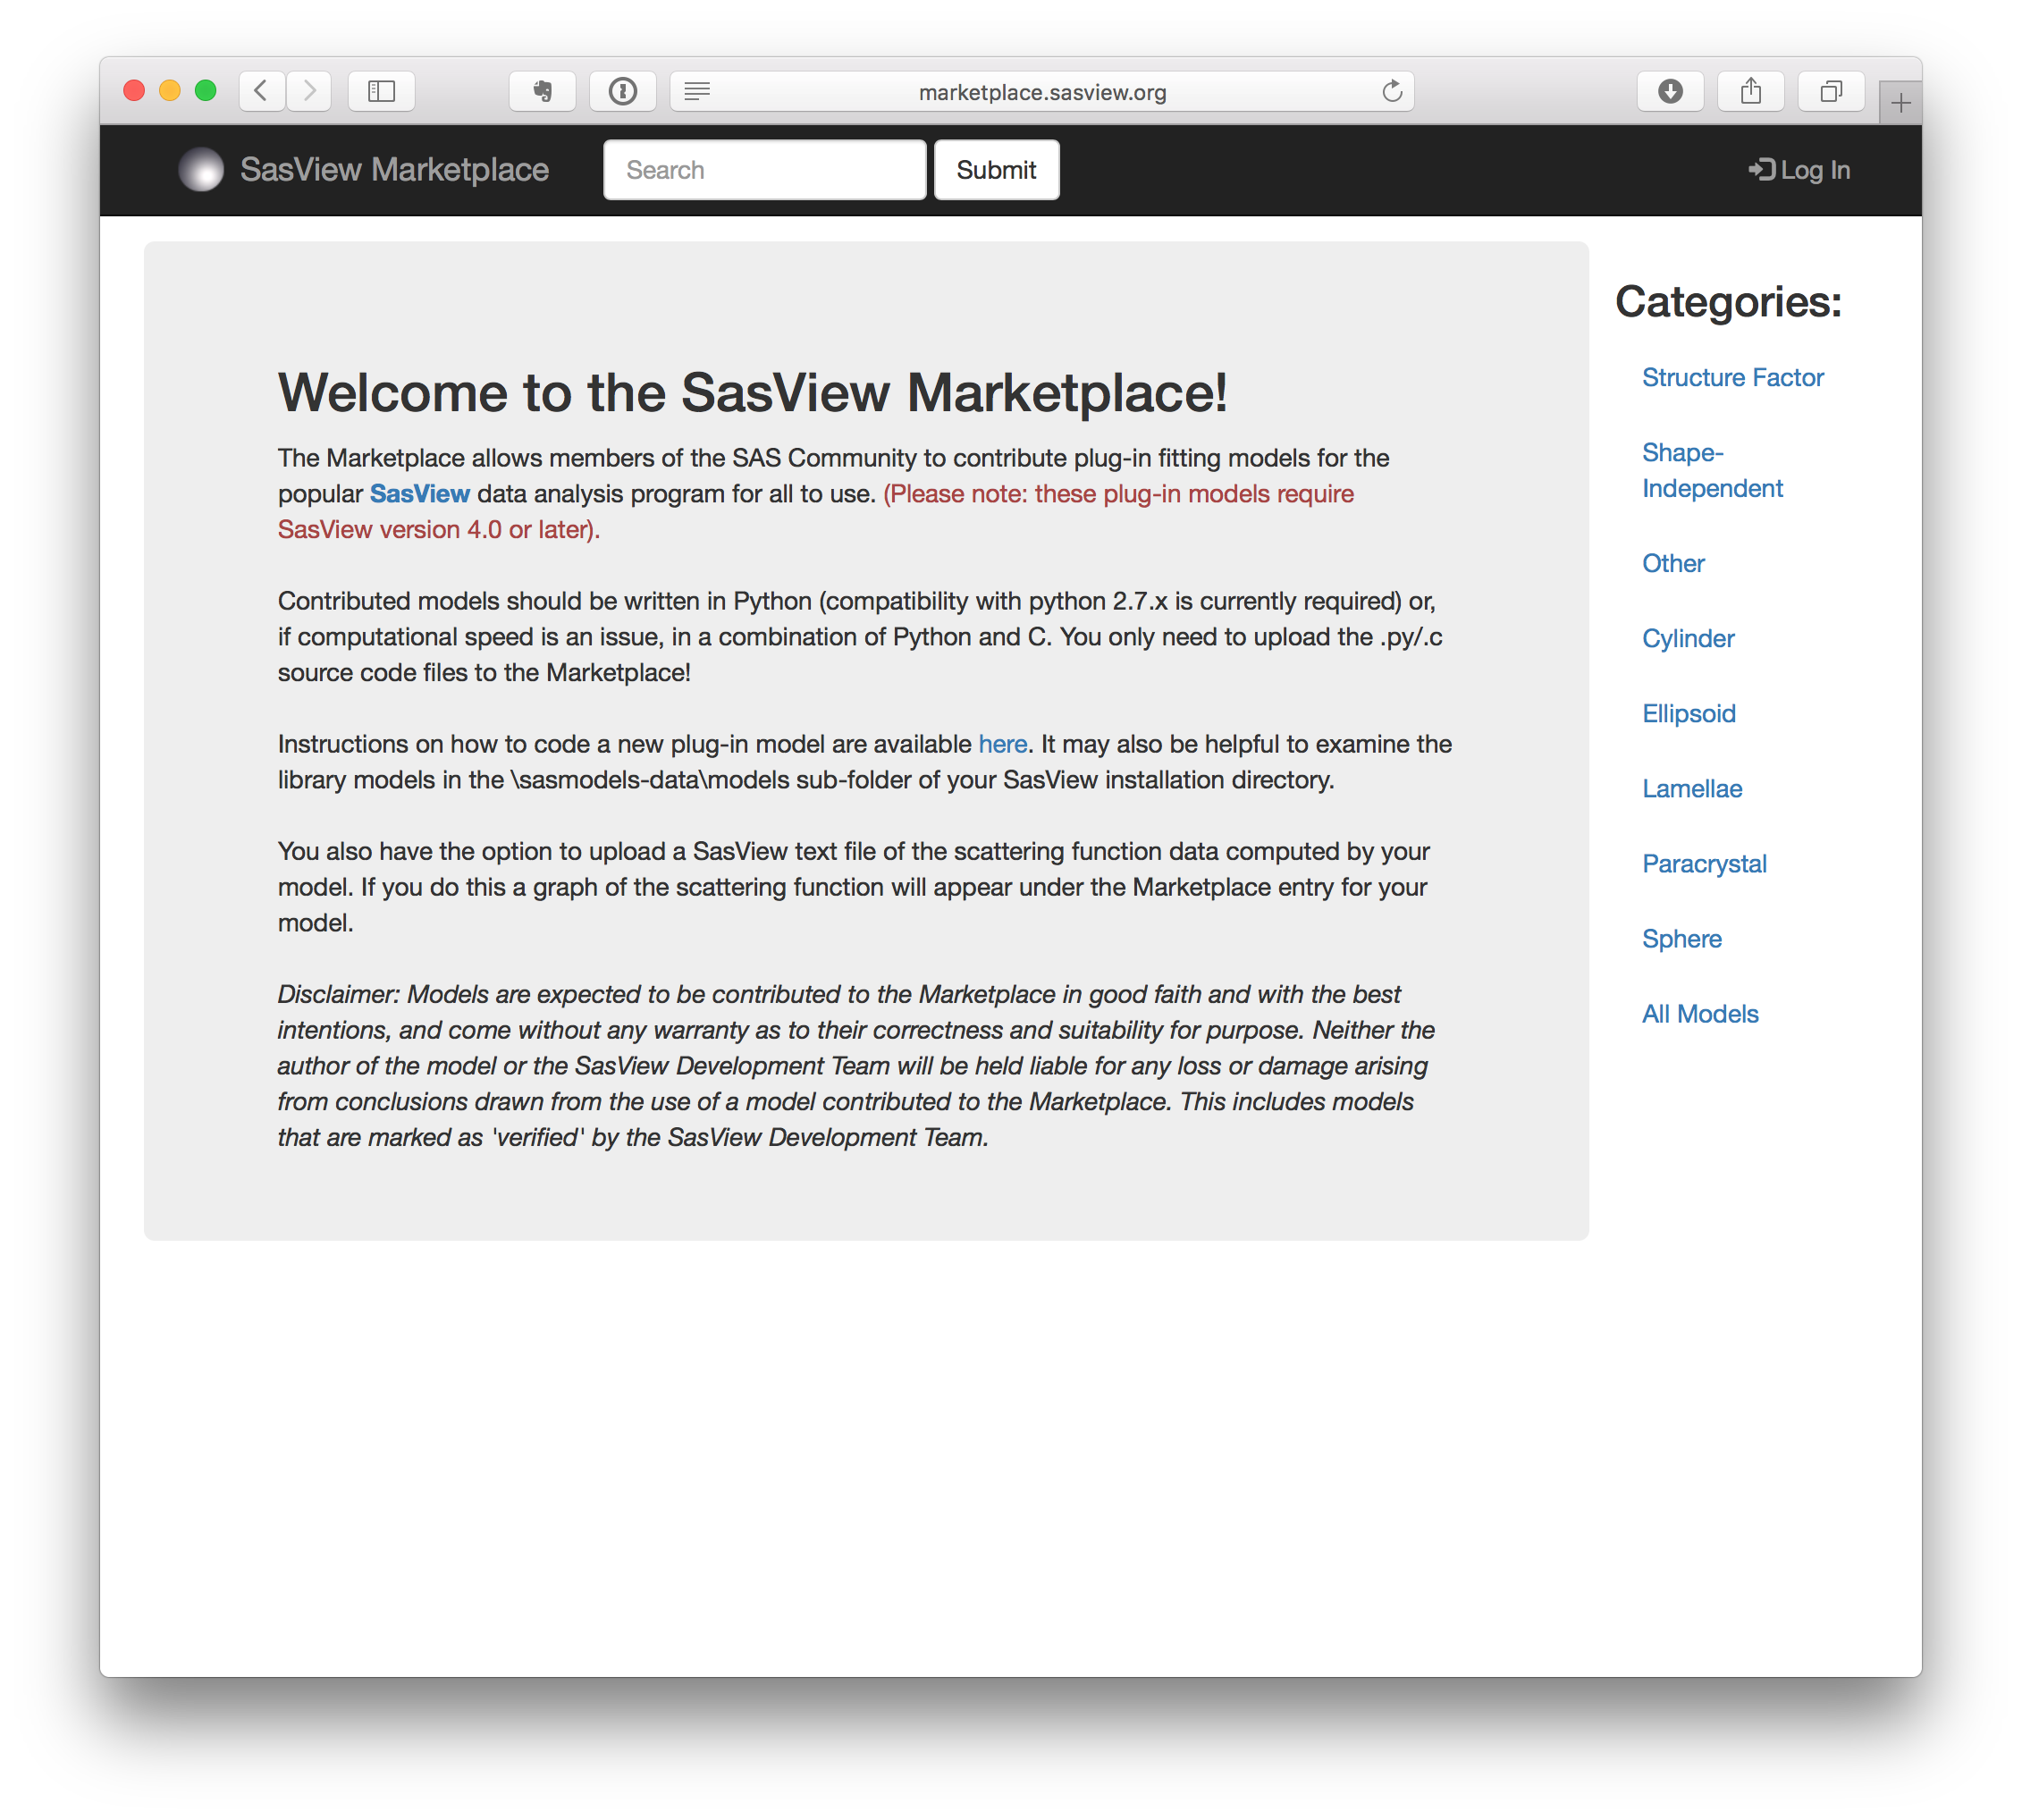
SasView Marketplace
Users can share their models with the community
Documentation & example output
Models can be tested and included in future releases of sasmodels & SasView
http://marketplace.sasview.org

Slide 23
SasView 4.1 is Out!
www.sasview.org
Official Releases available for Windows and Mac
Models
New models
New model package (sasmodels)
Separation of models from GUI
Simpler addition of models by users
Speed! GPU and parallel processing
Correlation Function Analysis
CCP13 corfunc algorithm
Documentation
Enhanced, updated documentation for models
SESANS
Automatic transform of SANS model to P(z)
Plotting and fitting of SESANS data from GUI
Example scripts for fitting SESANS data
Simultaneous fitting of SANS & SESANS

Slide 24
Future …
UI Refactoring (“SasView 5.0”)
Move to QT - current and well supported toolkit
Complete separation of GUI and calculation code
Provision of CLI & updated Python API
Sasmodels Enhancements
Return F(q) from models
Beta approximation
Coherent sums
Constraints refactor
Multi-GPU support
Interface with SasFit models
Documentation
Tutorials
Manual
And much more!
See Roadmap and Tickets

Slide 25
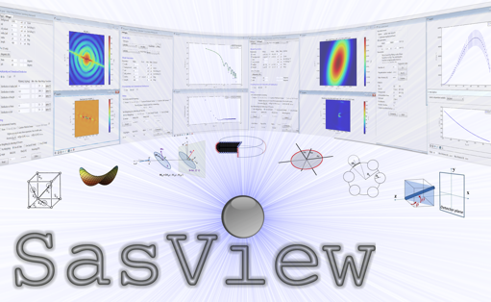
Questions?

Slide 26
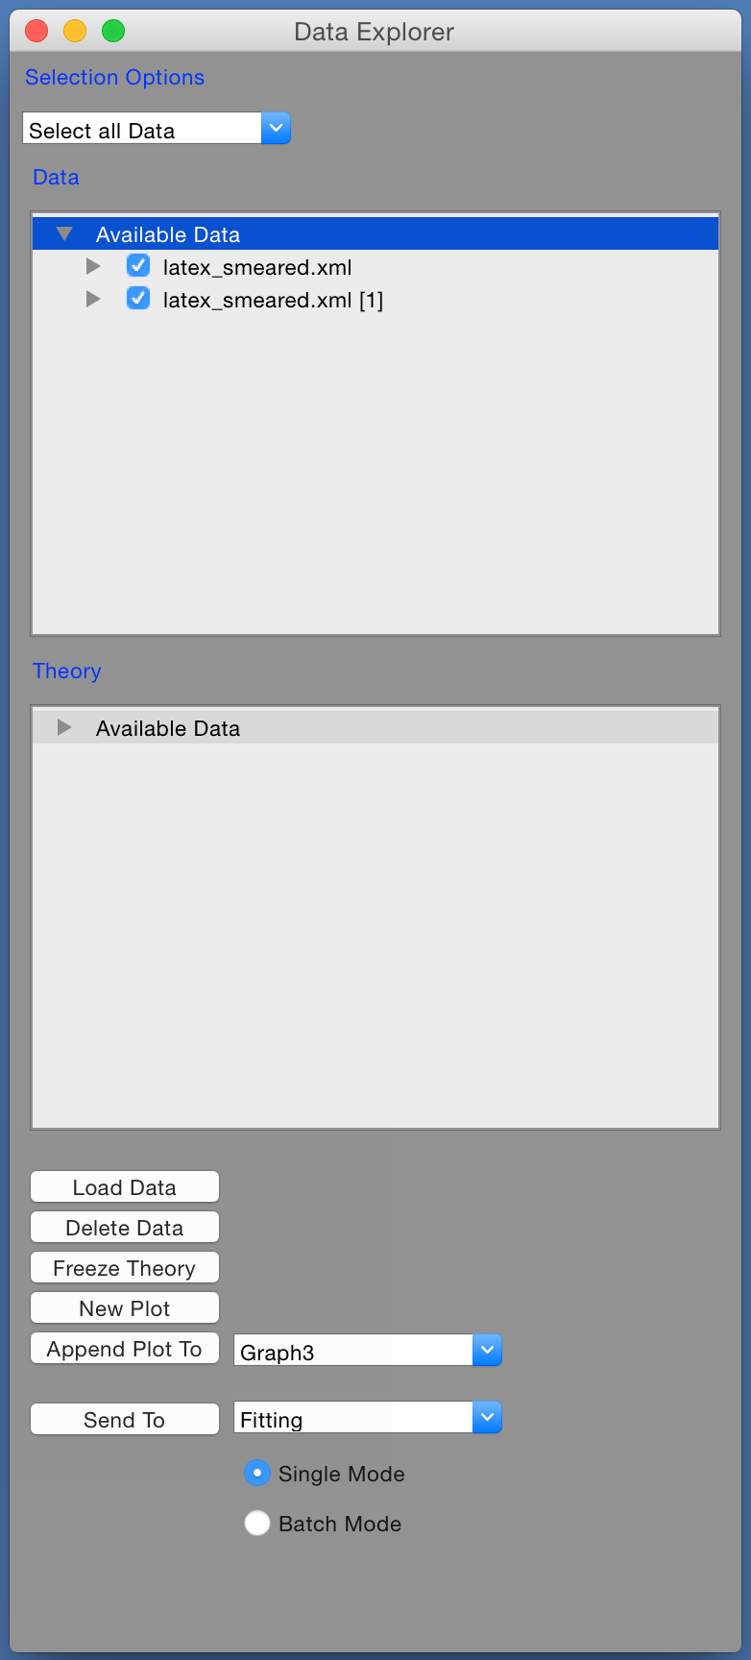
1D Analysis
Load Data …
Select Data Sets …
Here we have SANS & USANS from latex spheres
Send to Fitting …

Slide 27
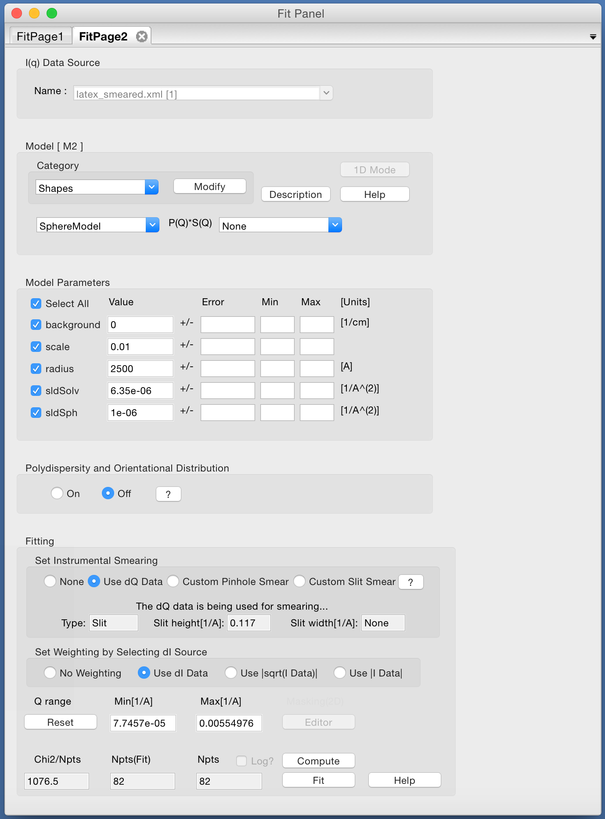
1D Analysis
Send to fitting …
Select a model …

Slide 28
1D Analysis
Send to fitting …
Select a model …
Set parameters …

Slide 29
1D Analysis
Send to fitting …
Select a model …
Set parameters …
Use resolution …

Slide 30
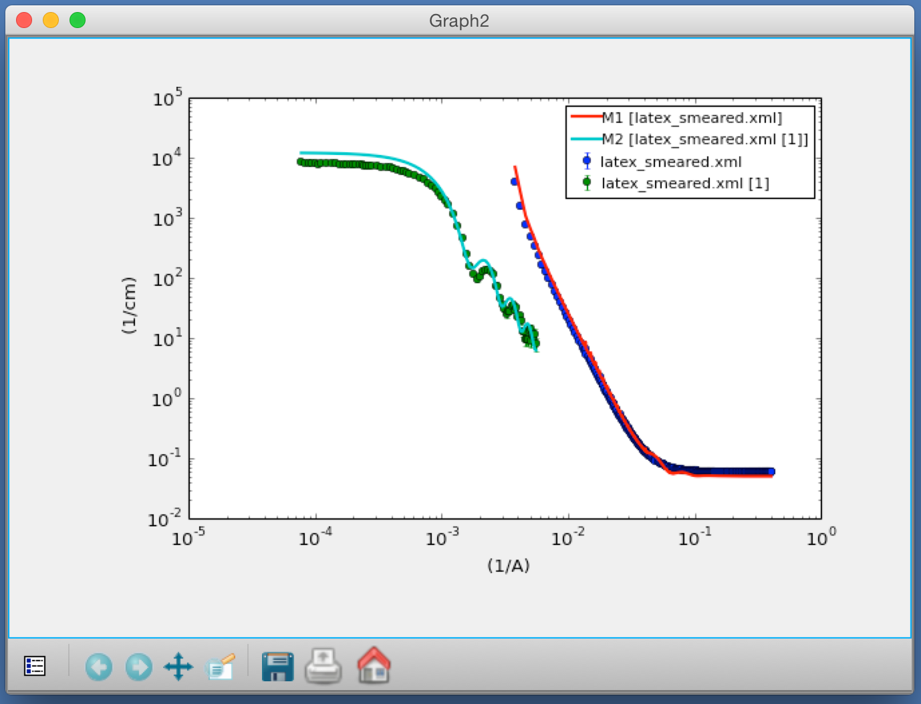
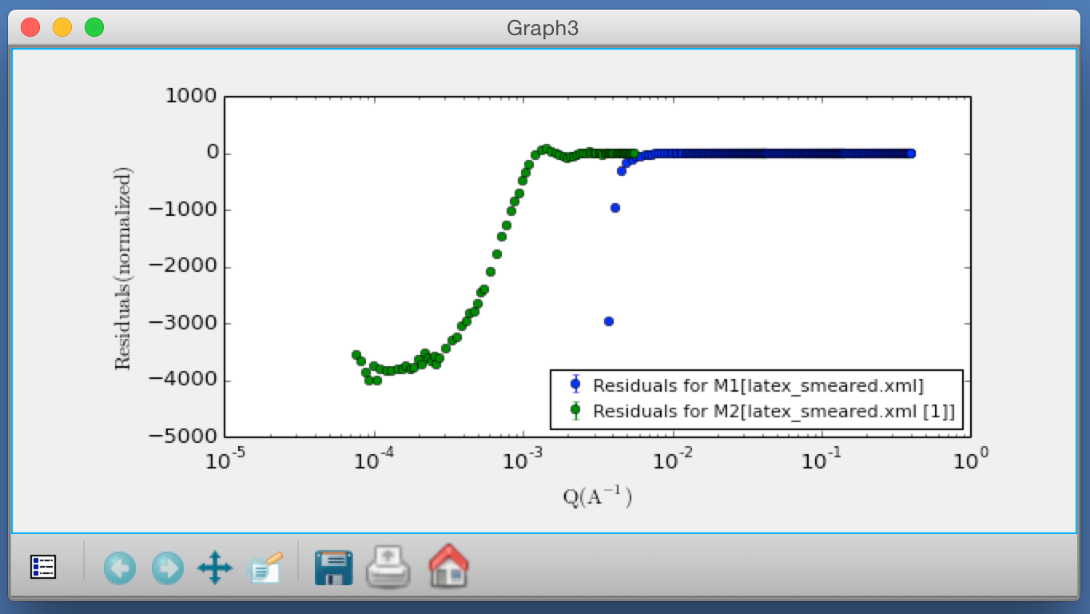
1D Analysis
Send to fitting …
Select a model …
Set parameters …
Use resolution …
How does it look?

Slide 31
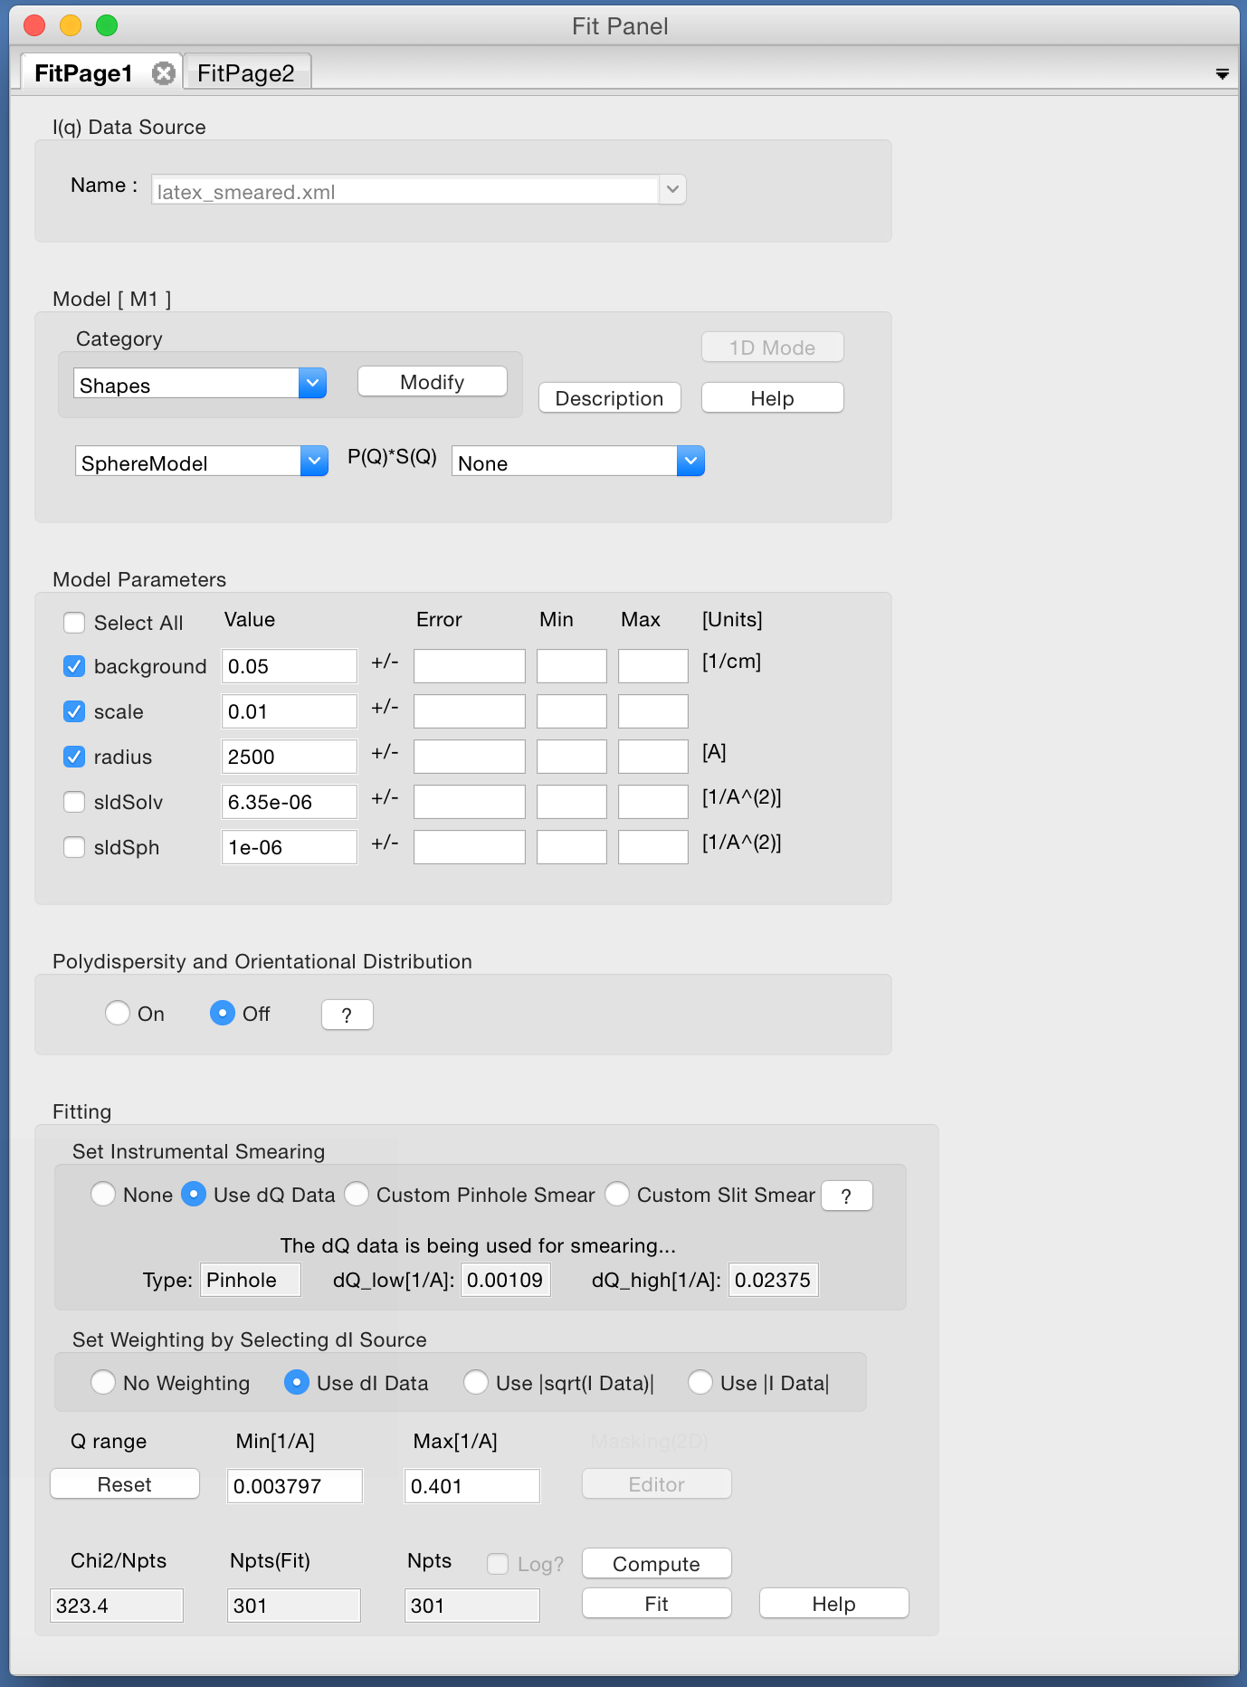
1D Analysis
Choose which parameters to fit …

Slide 32
1D Analysis
Choose which parameters to fit …
… and press the Fit button!

Slide 33
Constraints / Simultaneous Fit
But wait! We have two data sets of the same sample : SANS + USANS …

Slide 34
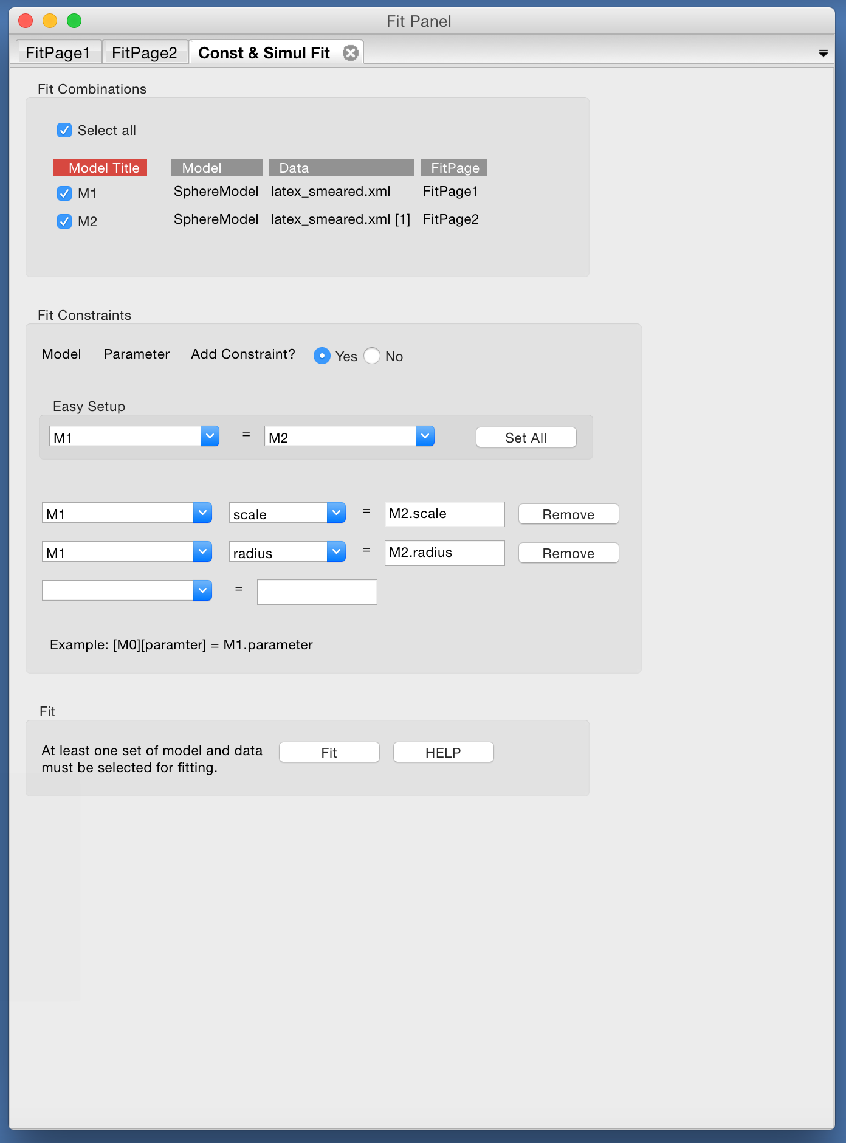
Constraints / Simultaneous Fit
But wait! We have two data sets of the same sample : SANS + USANS …
Set up a simultaneous fit …

Slide 35
Constraints / Simultaneous Fit
But wait! We have two data sets of the same sample : SANS + USANS …
Set up a simultaneous fit …
… with constraints

Slide 36
Constraints / Simultaneous Fit
But wait! We have two data sets of the same sample : SANS + USANS …
Set up a simultaneous fit …
… with constraints
Now press the Fit button!

Slide 37
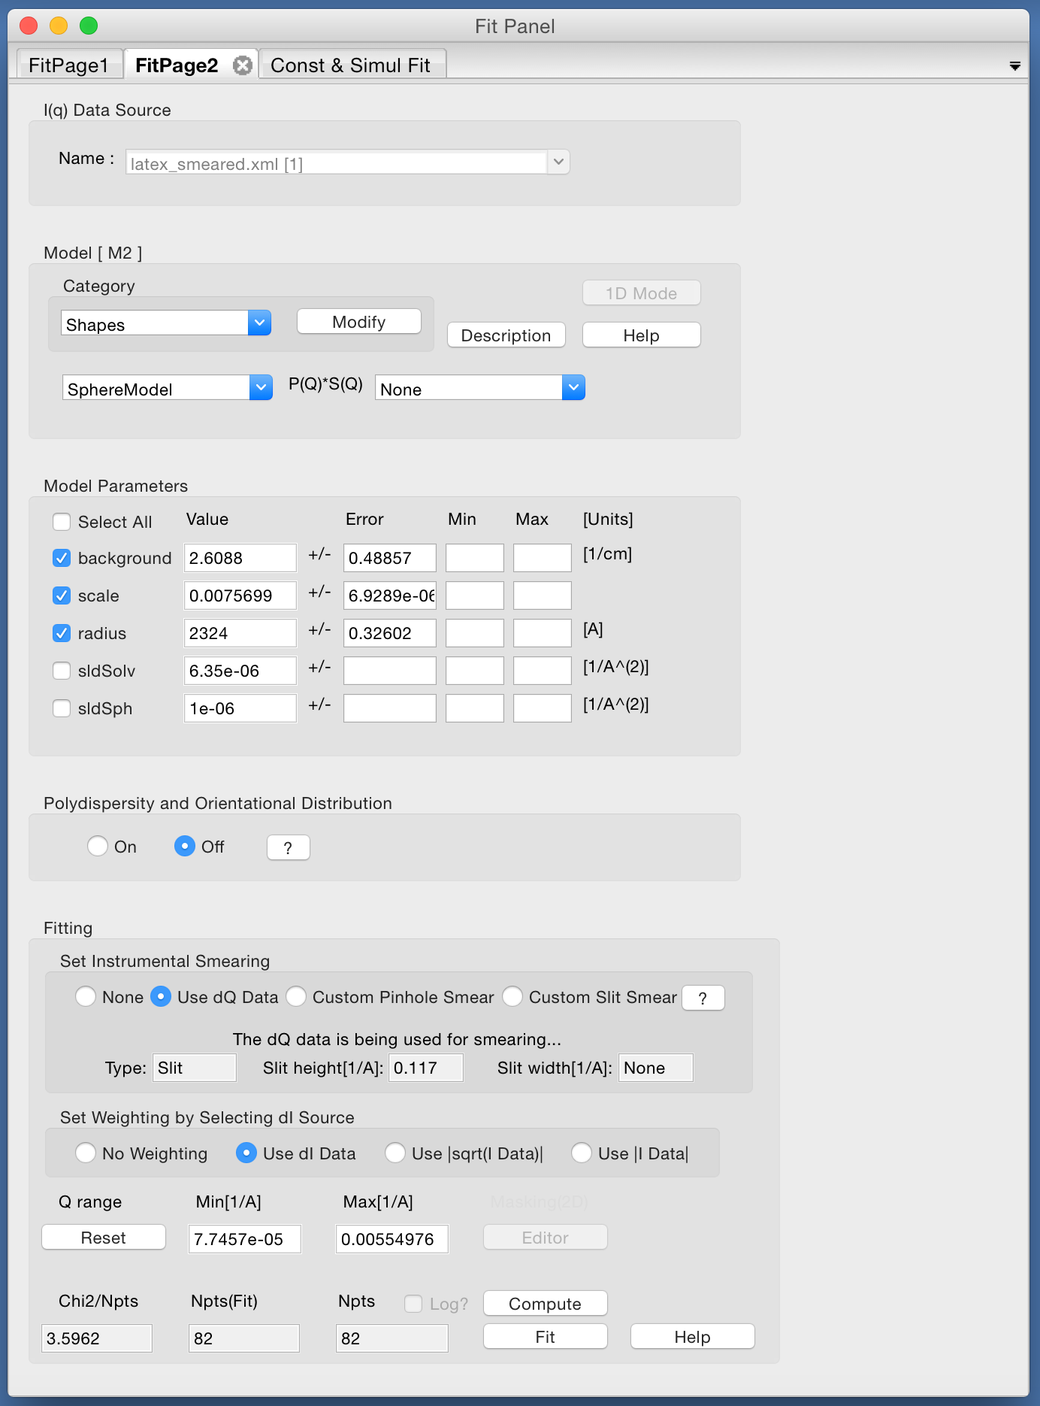
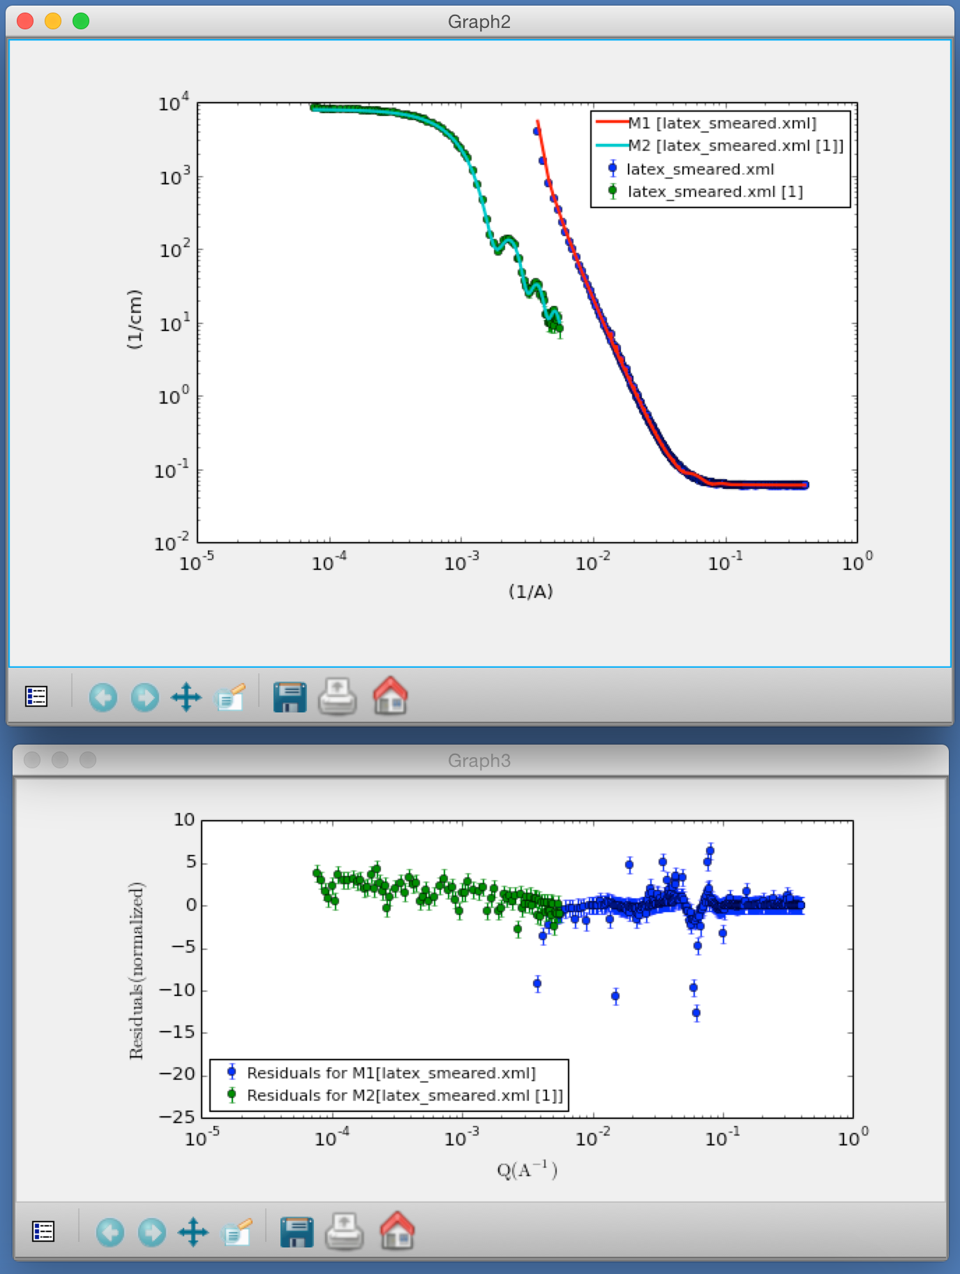
Constraints / Simultaneous Fit

Slide 38
Fitting Algorithms

Slide 39
Fitting Algorithms

Slide 40
Fitting Algorithms

Slide 41
Fitting Algorithms

